Slide 1

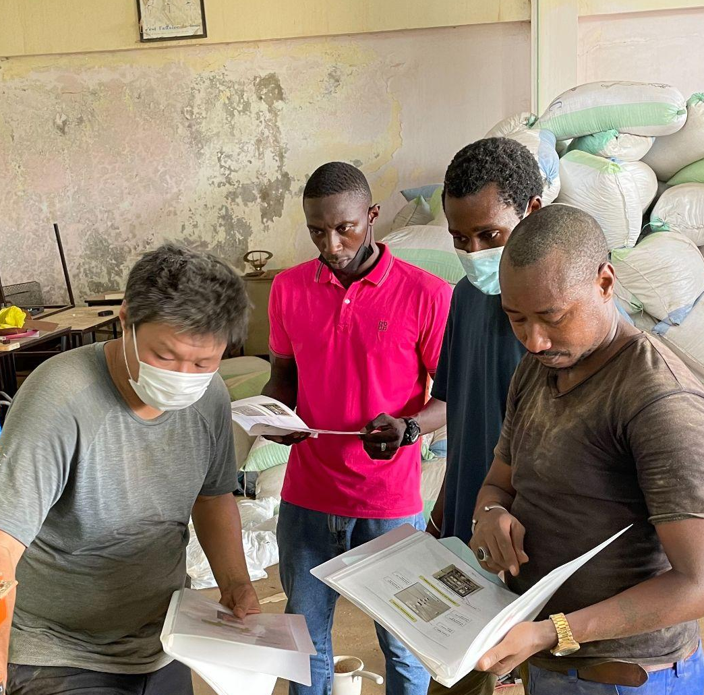
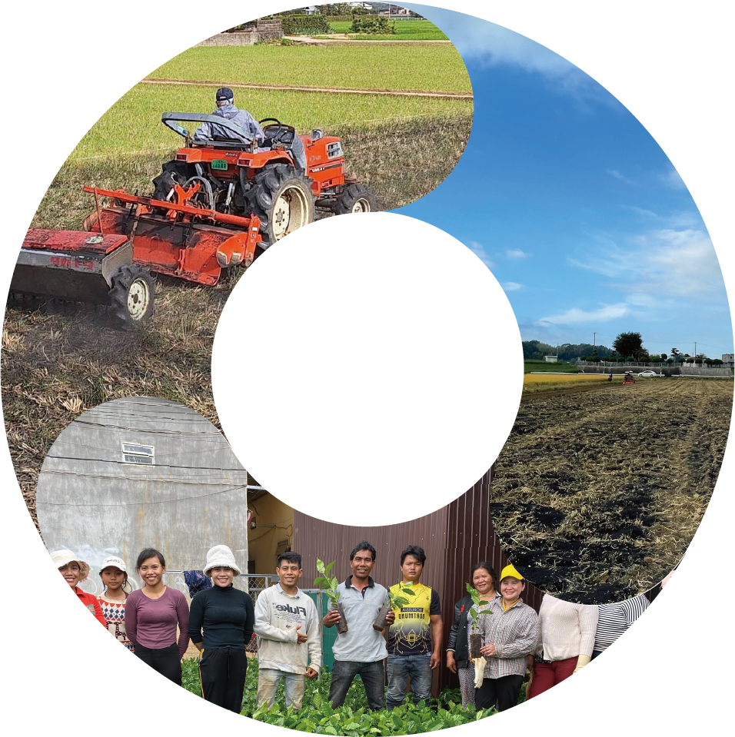
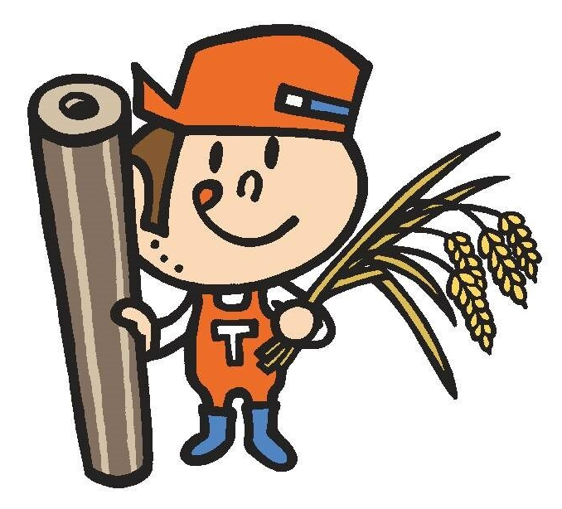
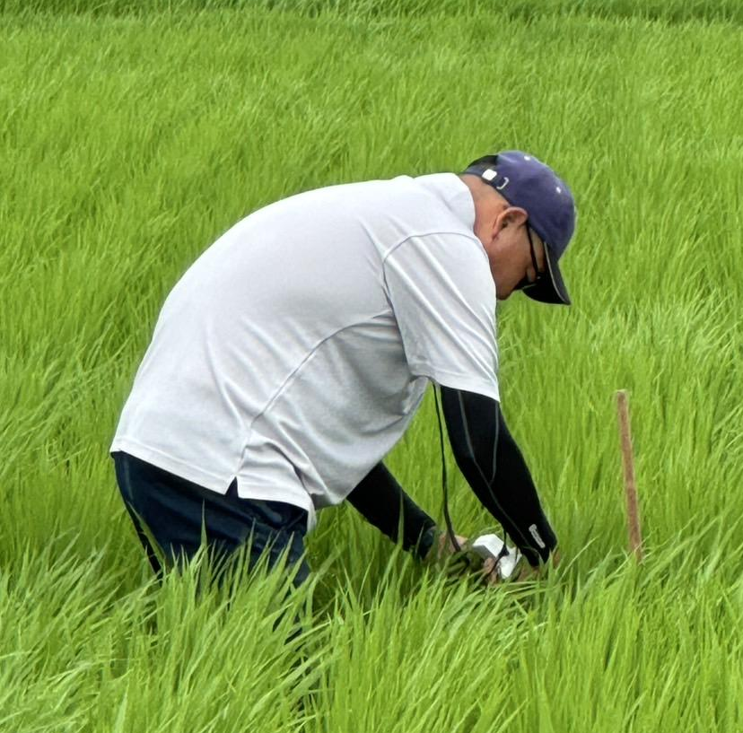
Cultivating
greenery
Biochar and Biomass Co-Firing for Sustainable Agriculture and Decarbonization
Creating the future of agriculture and people
Tromso Co., Ltd.
Protect
the green
Tromso CO., LTD.

Slide 2
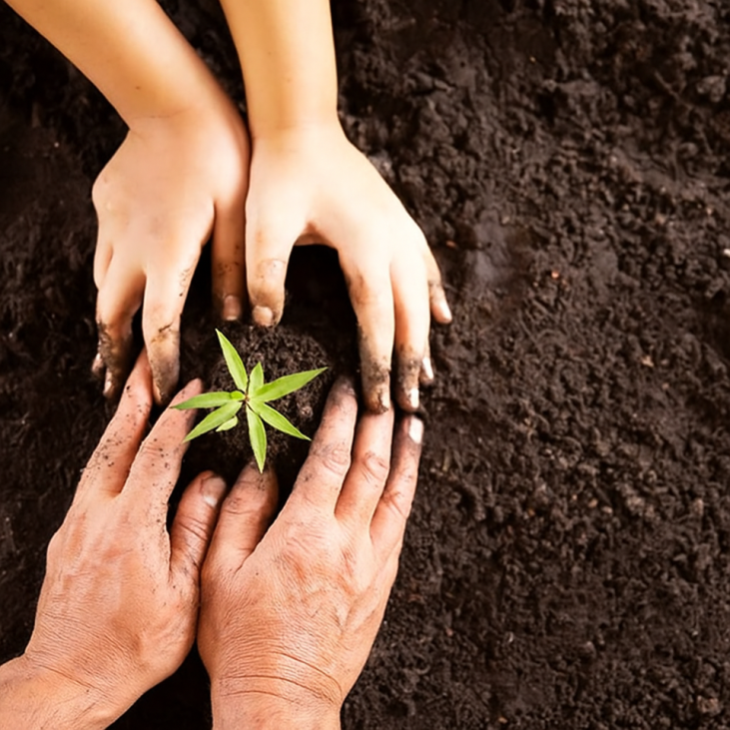
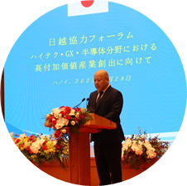
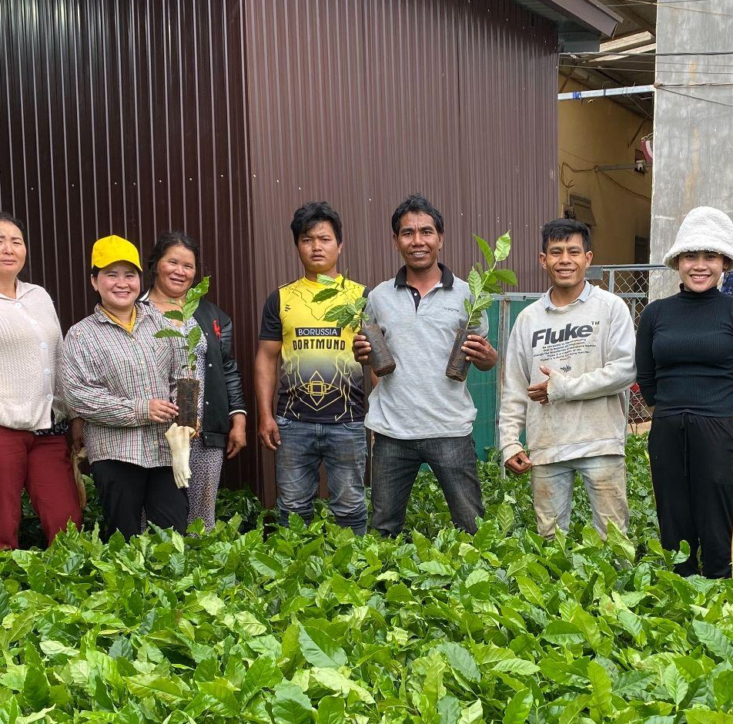

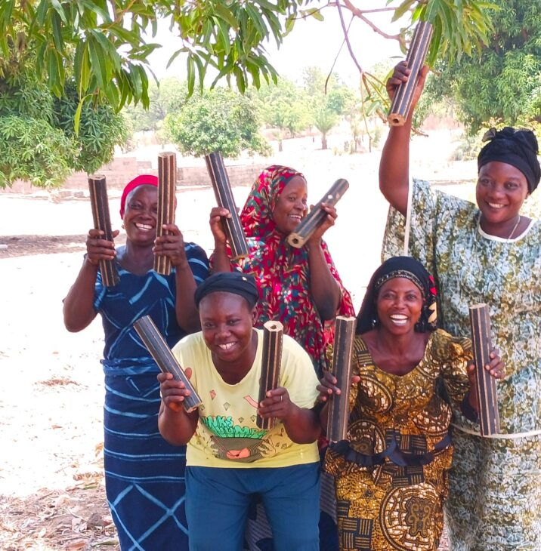
Company Overview
Company Overview
Tromso Co., Ltd.
Company Name
Agricultural demonstration projects for biochar business begin domestically and internationally
Tromso Co., Ltd.
Address
2022
〒722-2102 1182-6 Shigeicho, Innoshima,
Onomichi City, Hiroshima Prefecture
Establishment
October 19, 1994
2024
Capital
2019
54.98 million yen (including capital reserve of 24.99 million yen)
Construction begins on Japan's first biochar R&D center in Innoshima, Onomichi City, Hiroshima Prefecture
Masaaki Uesugi is appointed Representative Director.
New businesses are launched as the company's second startup.
Representative Director
2025
President and CEO: Masaaki Uesugi
Business Overview
Selected for the Ministry of Economy,
Trade and Industry's Global South Future Co-creation Project (large-scale demonstration project)
・Manufacture and sale of biochar
production machines
・Consulting on agricultural
management using biochar
・Sales of carbon credits associated
with biochar application
・Manufacture and sale of rice husk
solid fuel production equipment
2013
Expanding into Africa
Selected for JICA Private Sector Partnership Project
2007
1994
From marine manufacturing to land manufacturing:
Tromso Co., Ltd. established
Released "Grind Mill"
a rice husk solid fuel manufacturing device.

Slide 3

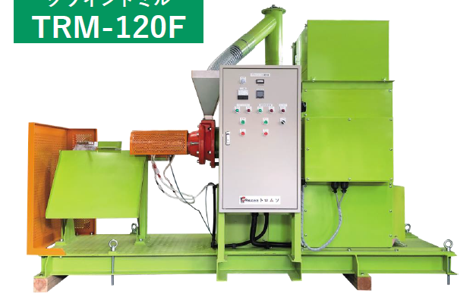
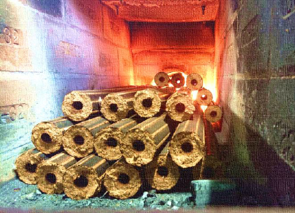
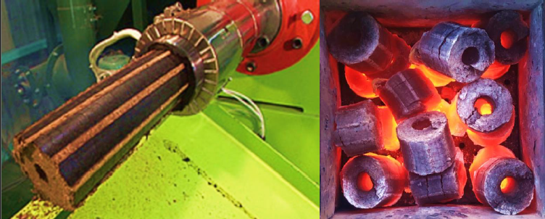
[Protects greenery] Promoting agricultural waste as a fuel alternative and reducing environmental impact
Rice Husk Solid Fuel Production Equipment Manufacturing/Sales
Overview
Point
Manufacturing, provision, and sales of machinery that utilizes agricultural waste such as rice husks as solid fuel (MOMIGARITE)
What is rice husk solid fuel
It can be used for a variety of purposes, not just for outdoor use, such as for heating greenhouses and as a fuel to protect fruit trees from frost. It is expected to be used as a primary fuel in developing countries.
Reduces carbon dioxide increase as an alternative fuel to coke and coal
*The effects of rice husk solid fuel and the results of the demonstration experiment are summarized in the Appendix.
グラインドミル
TRM-120F
Grind Mill
TRM-120F
Agricultural waste such as rice husks is solidified by heat. It is also possible to mix rice husks with other raw materials (wood chips, agricultural residue, waste mushroom beds, etc.) and solidify them, making it highly versatile.
Features
100% solid fuel made from rice husks
Calorific value is almost the same as firewood (Momighalite 3970kcal/kg, firewood 4000kcal/kg)
Virtually zero net CO2 emissions!

Slide 4
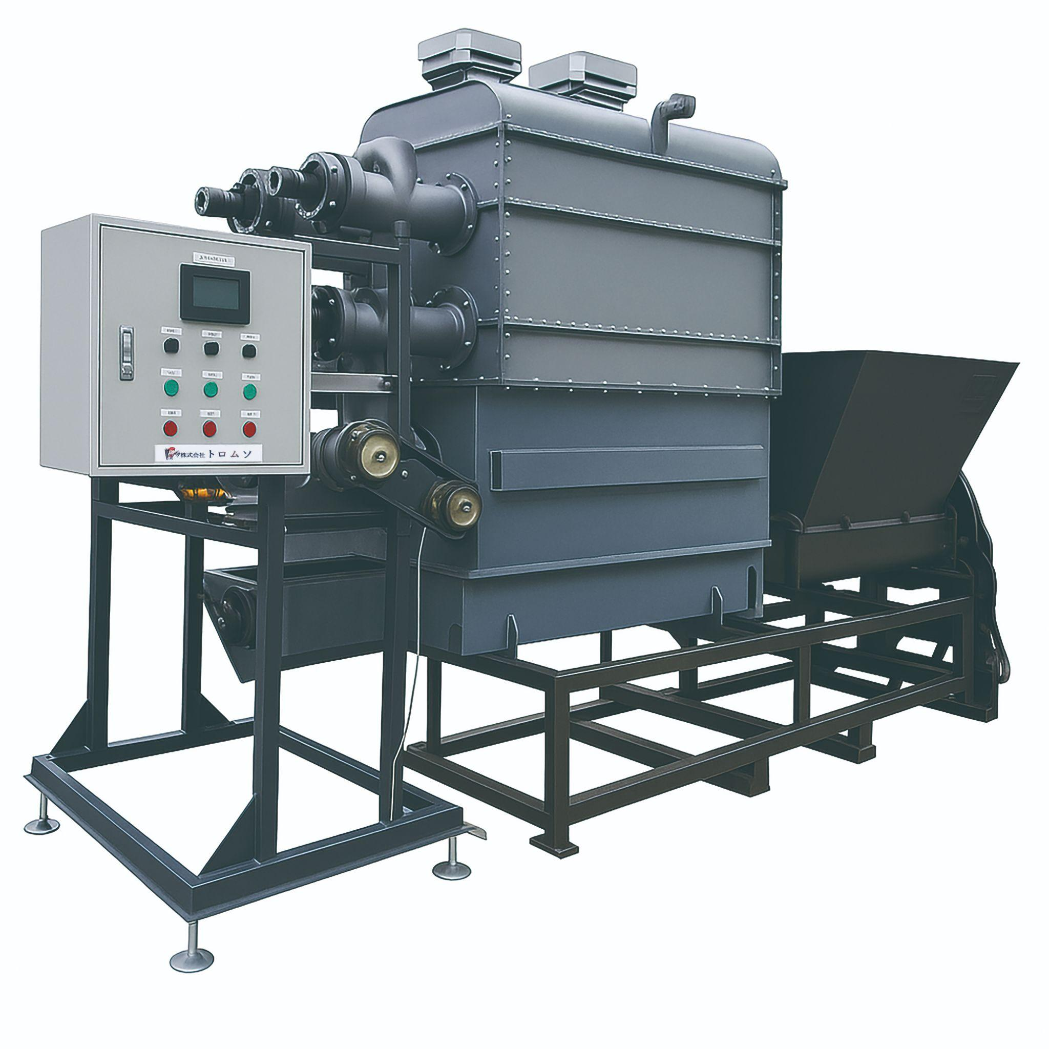
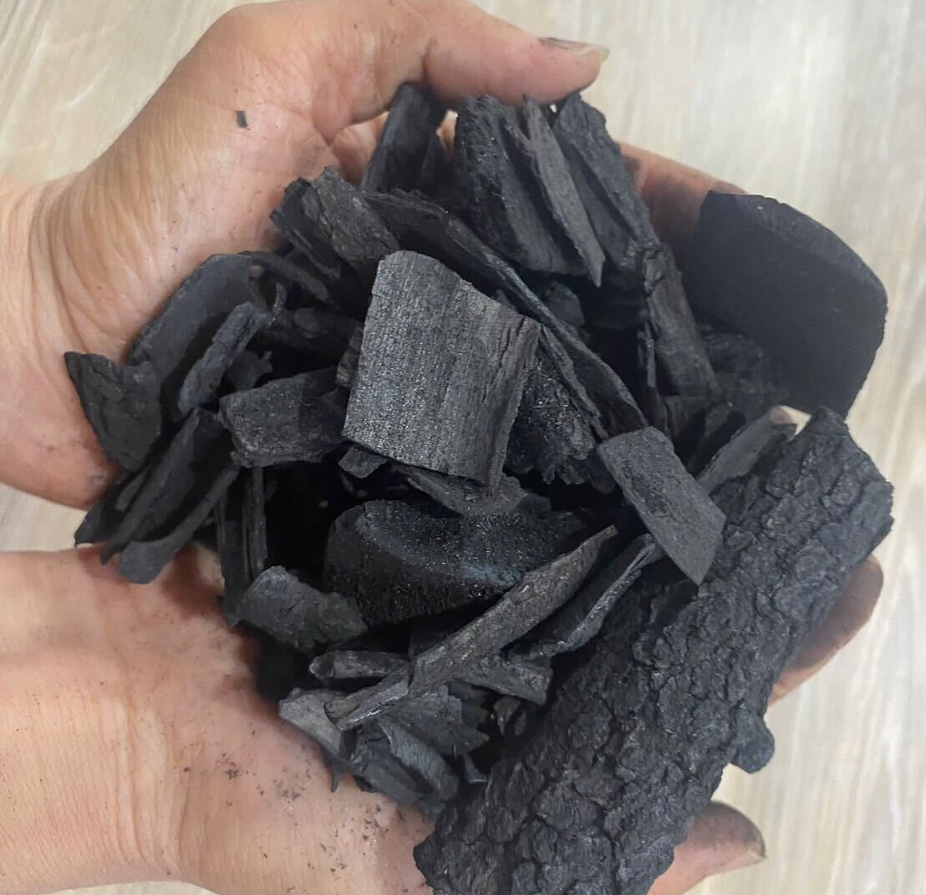
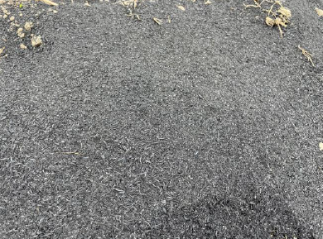
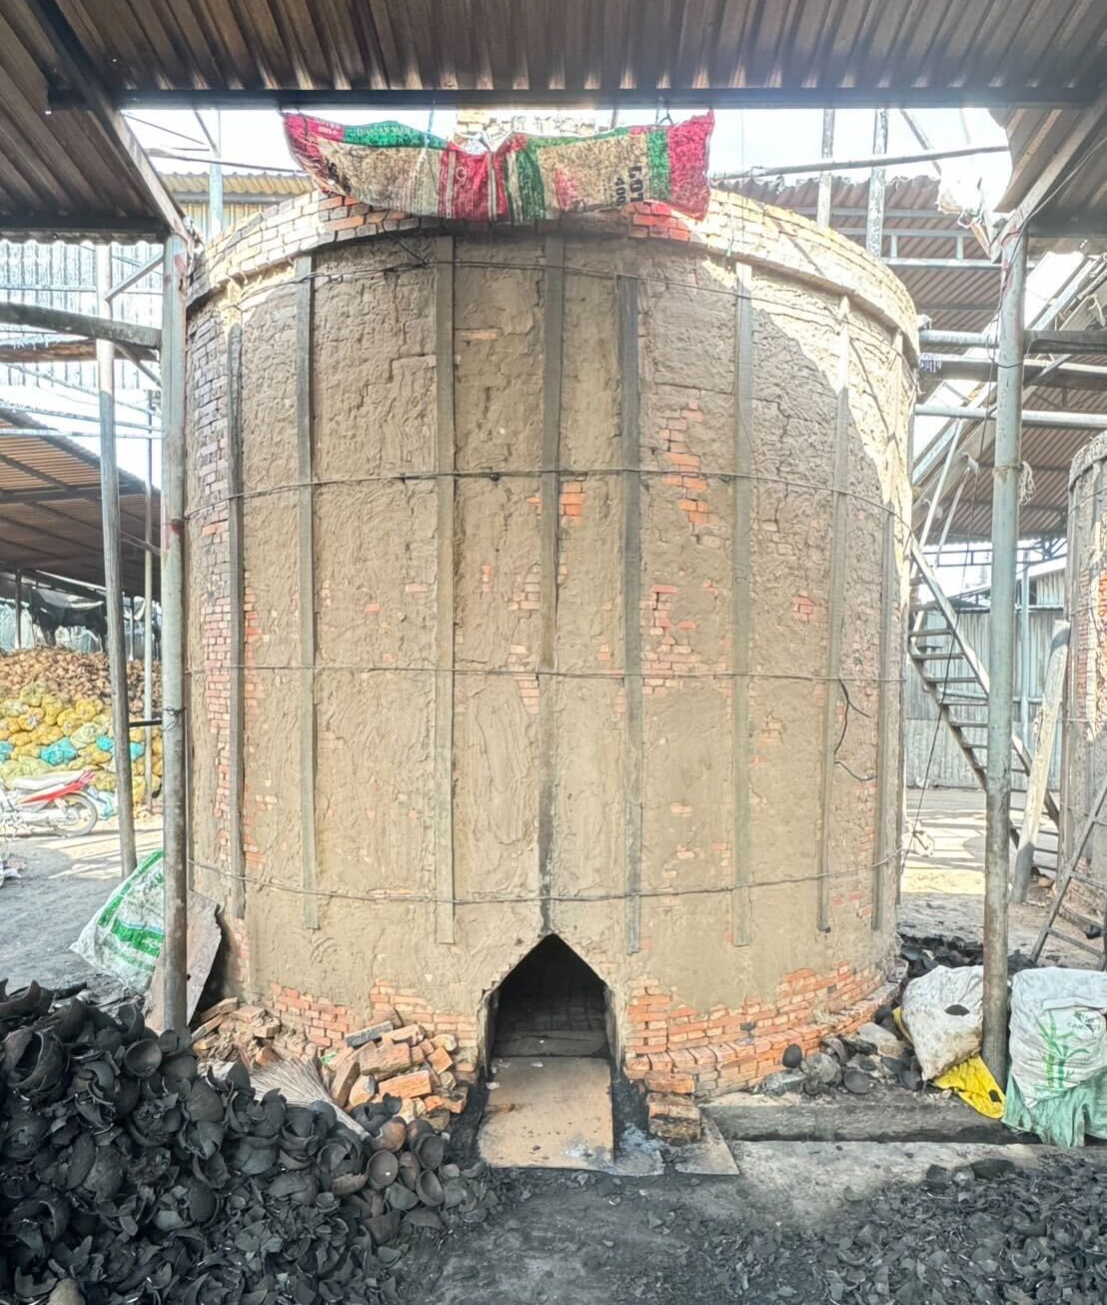
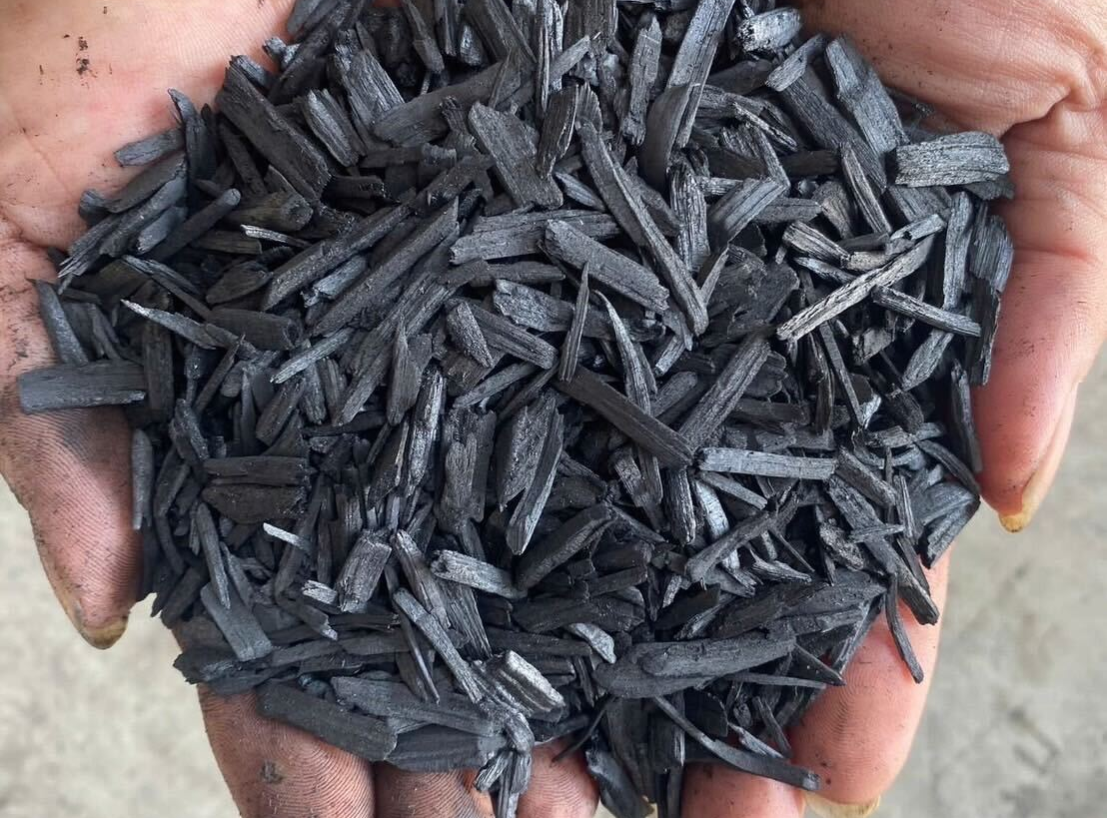
[Nurtures greenery] Improving crop yields and reducing costs
Biochar Production Equipment Manufacturing/Sales
Overview
Point
Manufacturing and sales of biochar production machines suitable for agricultural application, based on domestic and international field demonstration experiments.
Biochar Definition
A solid material obtained from heating biomass at temperatures above 350°C in a controlled oxygen-limited atmosphere (zero or low oxygen).
Raw Materials: Various organic residues (biomass) like thinned wood, bamboo, rice husks, other agricultural residues (mainly husks), and livestock manure.
Converts costly agricultural waste into beneficial agricultural resources.
*The effects of biochar and the results of the demonstration experiment are summarized in the Appendix.
Continuous Biochar Manufacturing Equipment
TCE-C002
Brick-type Biochar Manufacturing Equipment
TCE-B001
The photos show bark biochar (left), rice husk biochar (top right), and crushed bark biochar (bottom right).

Slide 5



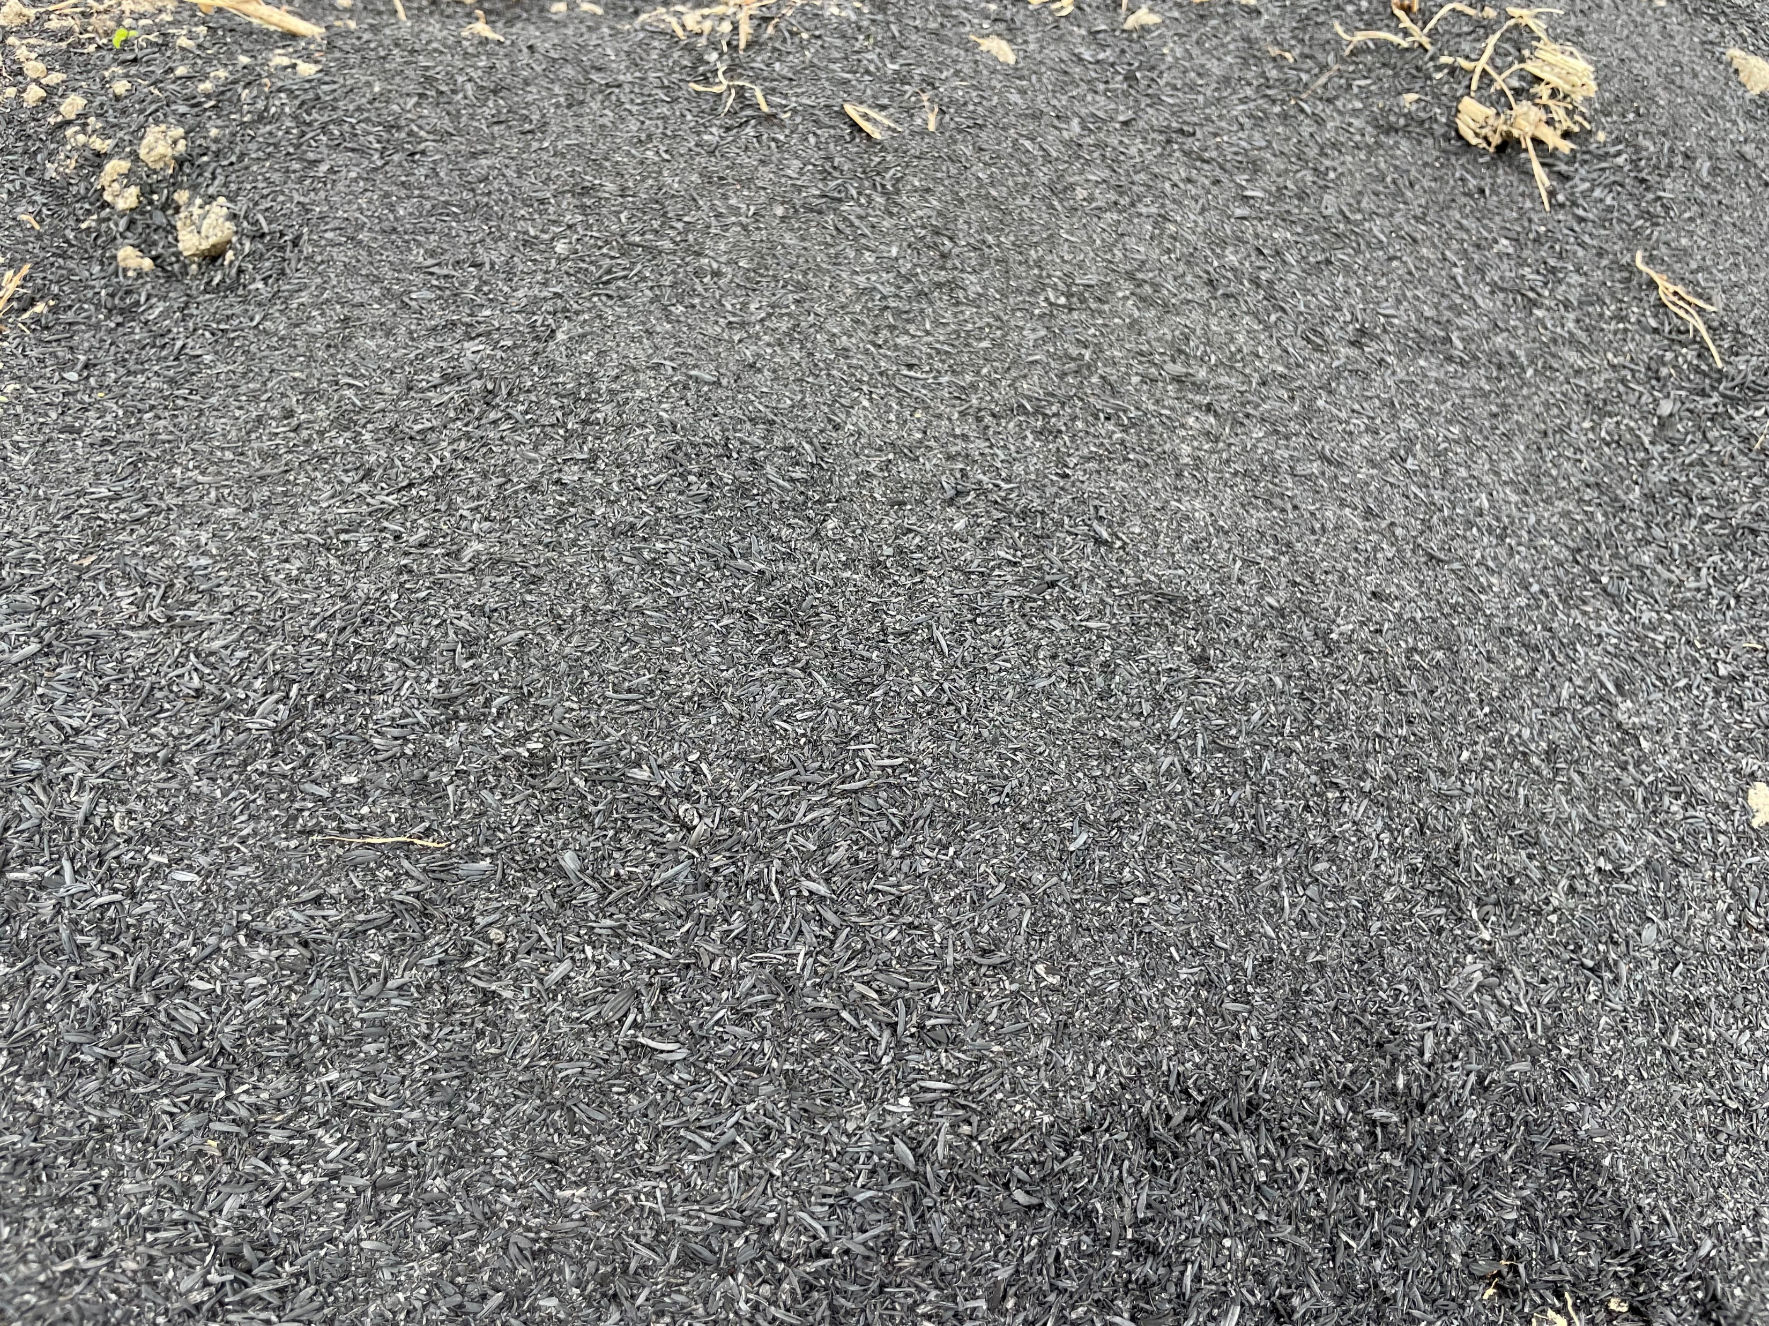

Effects of applying biochar to agricultural land
CO2
Effects of biochar in soil
・Unused biomass
・Waste biomass
→Rice husk, Livestock
excrement etc.…
Carbon sequestration
N2O emissions reduction
Nitrate leaching reduction
Soil
erosion
Water retention
Soil biology
Soil fertility
Crop yield
Wind erosion
Photosynthesis
Biochar
Thermochemical conversion
More Benefits
Less Benefits
C
C
Fumie Kishimoto(2022): Agricultural use of biochar and decarbonization - domestic and international trends and future prospects, Journal of Life Cycle Assessment, Japan, vol.18 No.1

Slide 6
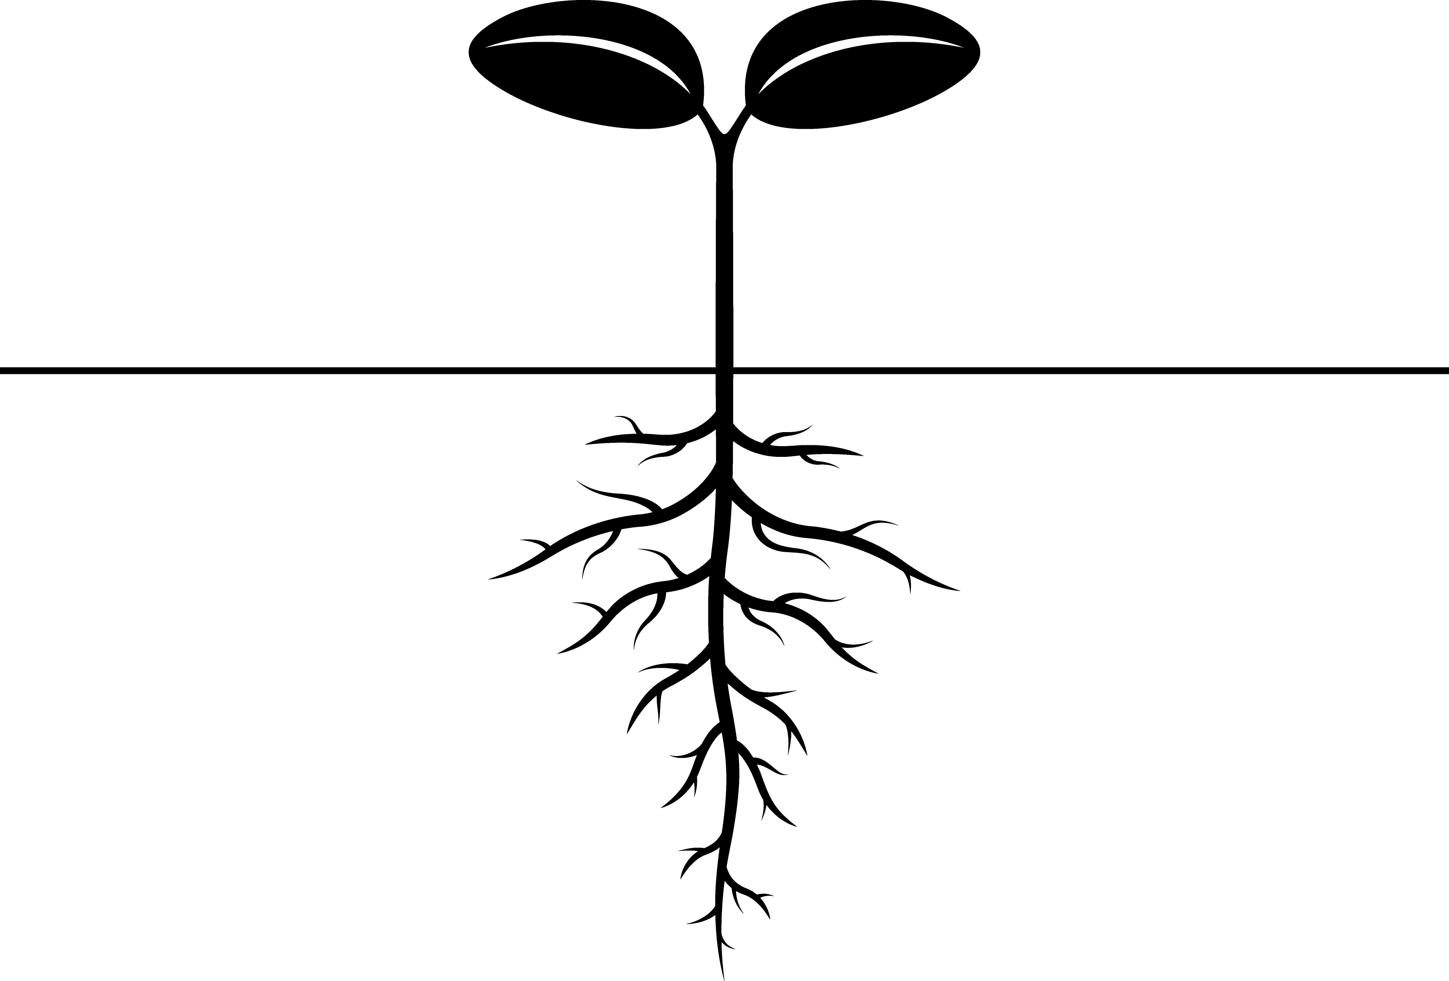
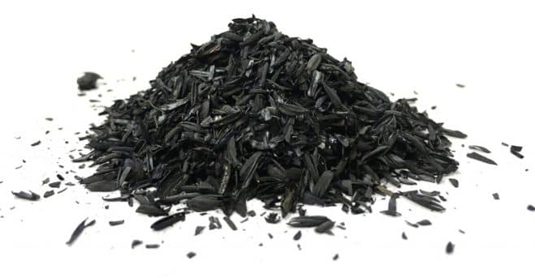

Effect of reducing chemical fertilizer use by applying biochar to farmland
High K content
Adsorption of Ca⁺⁺, Mg⁺⁺, K⁺, NH4⁺, etc…
Biochar
K⁺
K⁺
K⁺
NH₄⁺
ー
ー
ー
K⁺
K⁺
K supply
Biochar
K⁺
ー
ー
Most K in biochar is present in soluble forms, released in the short term after application to soil and is readily available to plants. (Joseph et al., 2021)
NH₄⁺
ー
ー
NH₄⁺
ー
-Effects of pyrolysis temperature on biochar properties-
Low temp.
High temp.
High CEC➤Adsorbs and retains cations in soil
Cation exchange capacity (CEC)
Mineral remained
Absorbance capacity
Biochar yield
Carbon sequestration
high
high
low
high
low
low
low
high
low
high
High mineral remained
➤Biochar has the potential to be an alternative to chemical fertilizers such as K.

Slide 7
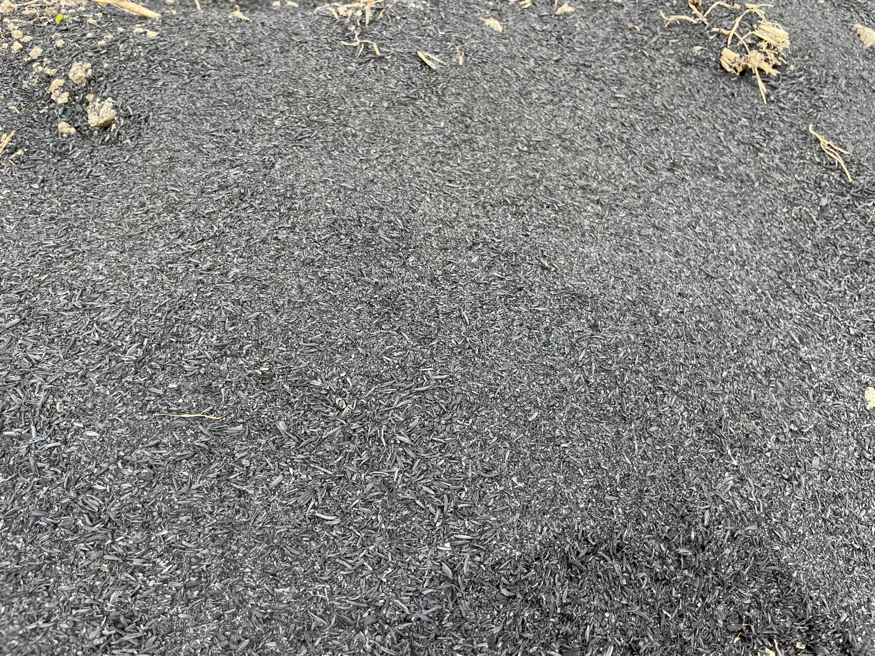
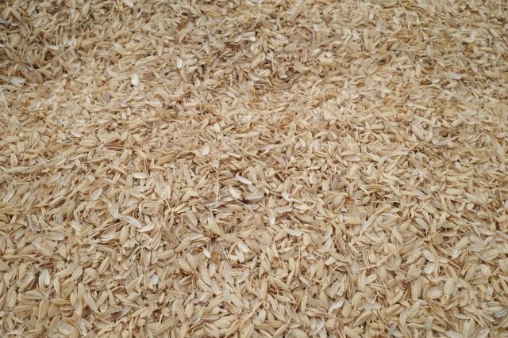
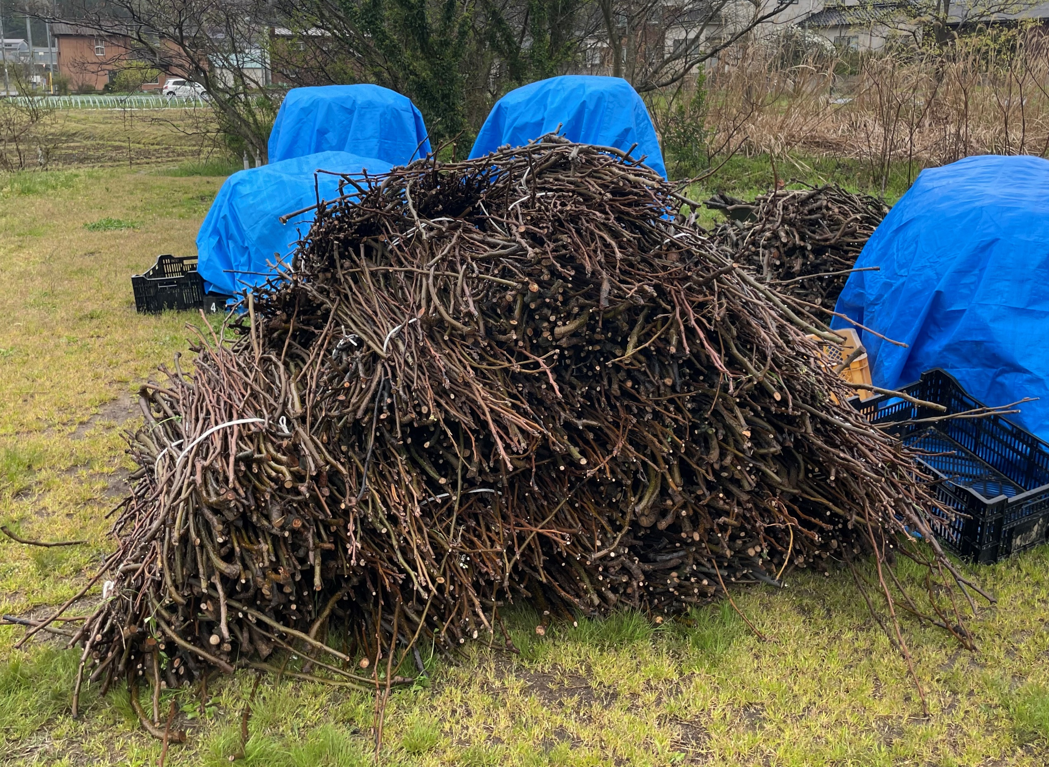
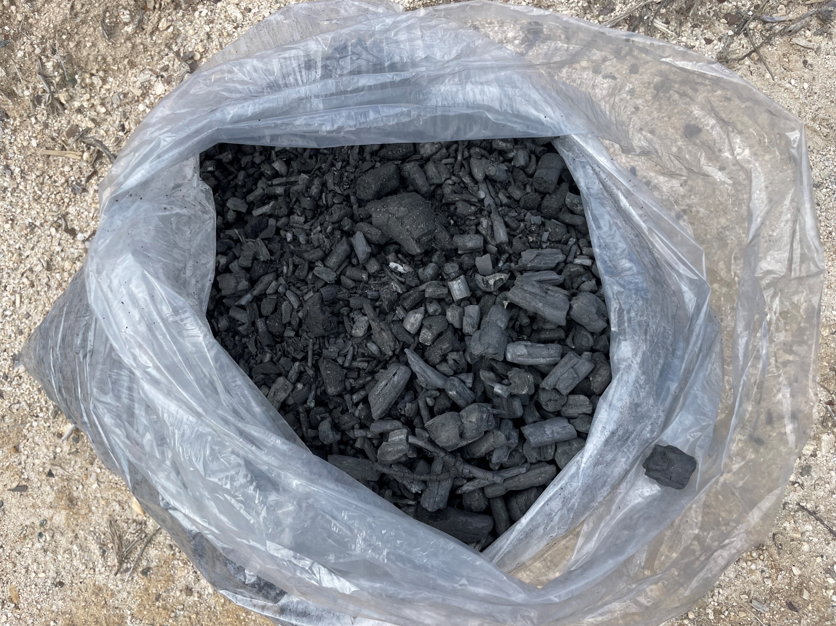





Carbon storage effect of biochar
Carbon that is difficult
to decompose
by microorganisms
Photosynthesis
CO2
Carbonization
Biochar
Plowing into farmland
Plowing into farmland
CO2
CO2
Carbon Sequestration<
Carbon Sequestration>
CO2
CO2
Soil Carbon
Soil Carbon
< Disassembly
< Disassembly
>Disassembly
>Disassembly

Slide 8
Carbon storage by biochar
Carbon storage
= CO2 storage after project implementation - CO2 emissions from project implementation
= Amount of biochar added to soil (t) x carbon content x carbon remaining rate after 100 years x 44/12
CO2 emitted during the transportation of biochar raw materials and biochar
Ex. Based on the rice cultivation demonstration experiment conducted by Tromso in Akita Prefecture
STtotal (Carbon Storage)
= 1.17tCO2 - 0.08tCO2
=1.08 tCO2
STpj (CO2 storage volume after project implementation)
= 1tC× 0.49% × 0.65% × 44 / 12
= 1.17 tCO2
Raw material: rice husk
➤Carbon Content: 0.49
➤ Carbon remaining rate after 100 years: 0.65

Slide 9




Why Only Tromso Can Do This?
We provide comprehensive support from biochar production to carbon credit application and sales, creating a system where profits reach producers.
特徴
Conventional Model
Tromso Model
Company Ａ
Company Ｂ
Company Ｃ
Equipment Manufacturing
Agronomic Guidance
Various Analyses
Equipment Manufacturing
Agronomic Guidance
Various Analyses
A fragmented structure
with different areas of application
One-stop service
from manufacturing to analysis to distribution

Slide 10
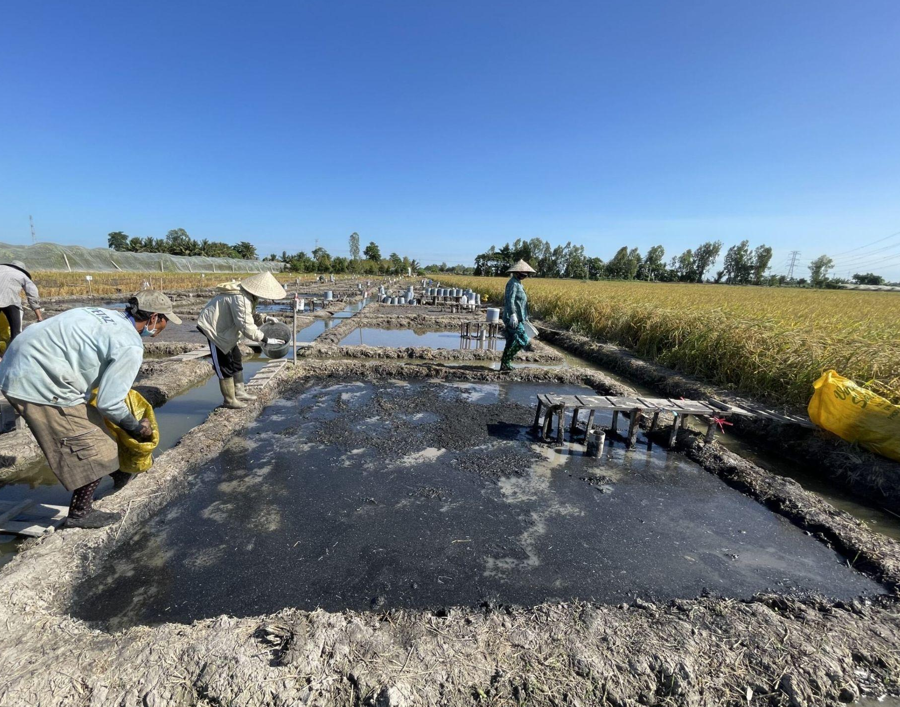
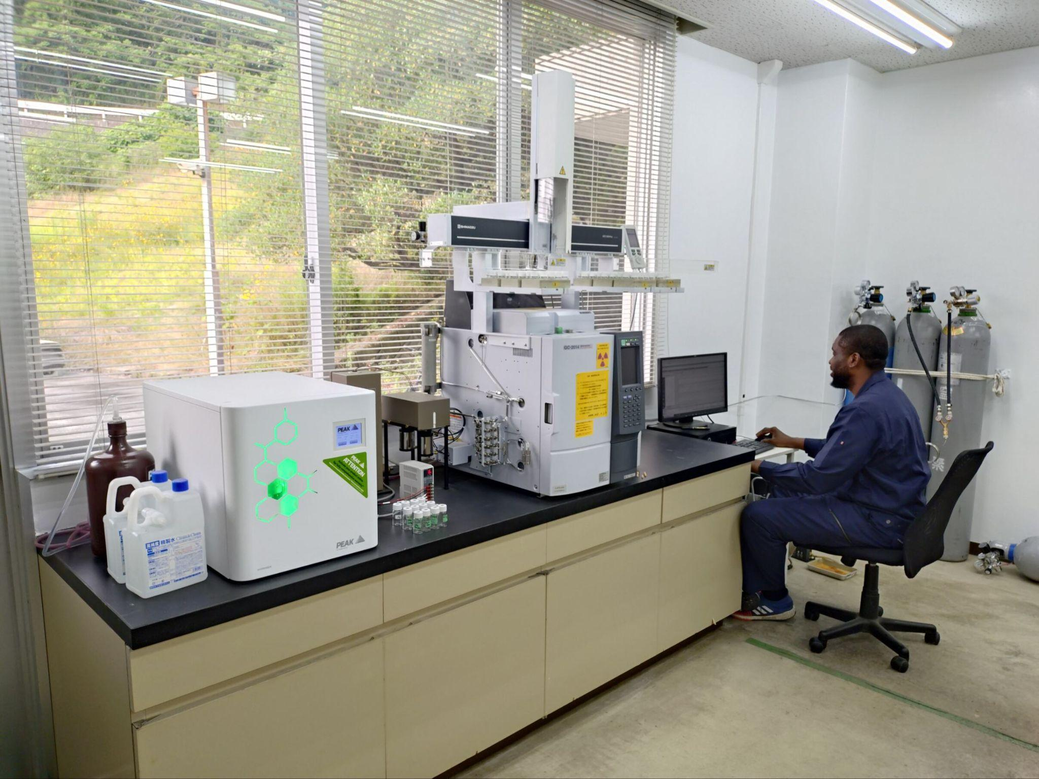
[Nurtures greenery] Promoting crop yield improvement and cost reduction by resolving the lack of technology and information
Agronomic Support（Agronomic Guidance・Various analyzes）
Agronomic Support
Various analyzes
Provision of agricultural technology and advice on biochar application
Quantitative analysis of greenhouse gases, soil analysis,
related to biochar utilization
Overview
Overview
・Support for fertilizer design that
reduces the application of chemical
fertilizers
・Agronomic guidance to maximize carbon
credits
・Analysis of fertilizer reduction effects
・Consultation and advice on sales
channels
・Analysis of soil and gas samples
collected in domestic and
international demonstration
experiments
・Contracting for elemental analysis,
GHG emission analysis, etc.
Complete support from agricultural consulting to analysis
Building a one-stop system to maximize carbon credit creation

Slide 11
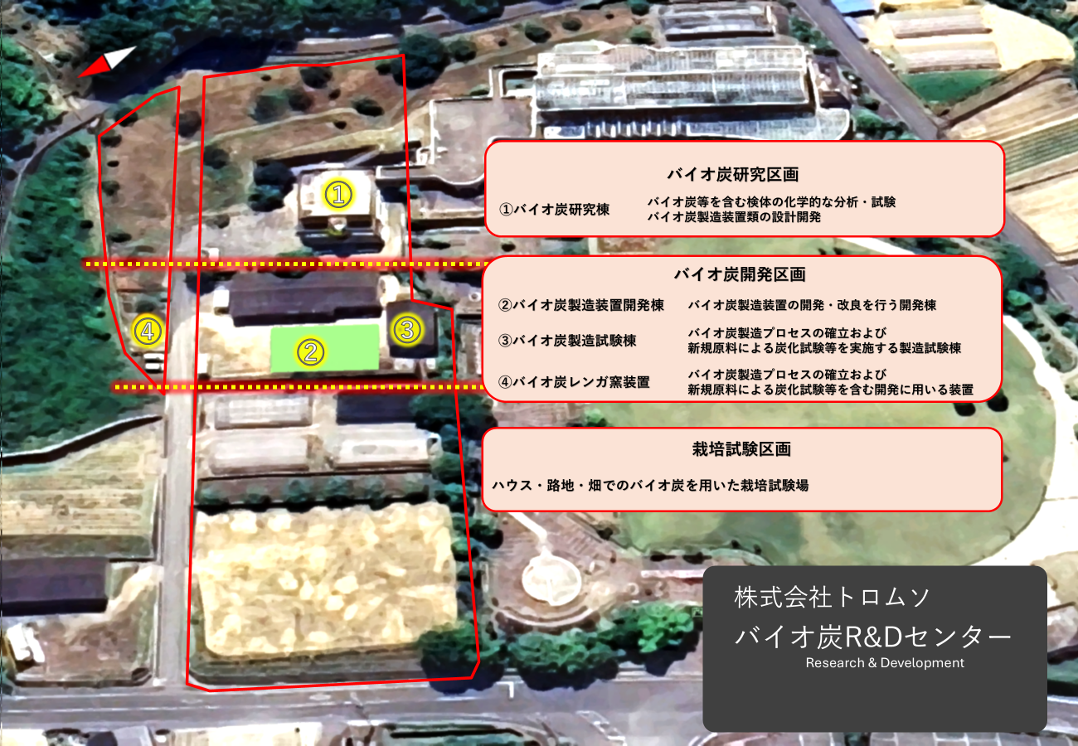
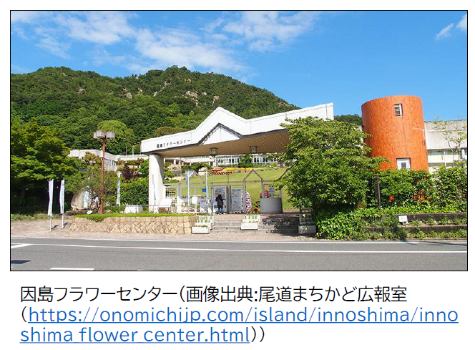
[Nurtures greenery]
Biochar R&D Center Establishment
Utilizing the Innoshima Flower Center as the "Biochar R&D Center,"
a research and development base related to biochar.
Roles of the R&D Center (3 Sections):
Biochar Research Section
        Analytical services to confirm biochar quality and application effects, including elemental analysis and greenhouse gas analysis. Accepts trainees from Japan and abroad (e.g., Ukrainian trainees planned for 2026/1 as part of a UNIDO Ukraine Reconstruction project).
        Biochar Development Section
Cultivation Testing Section
        Equipment development, test runs, and operating tests under various conditions.
Cultivation tests using biochar prototypes from the Development Section.

Slide 12
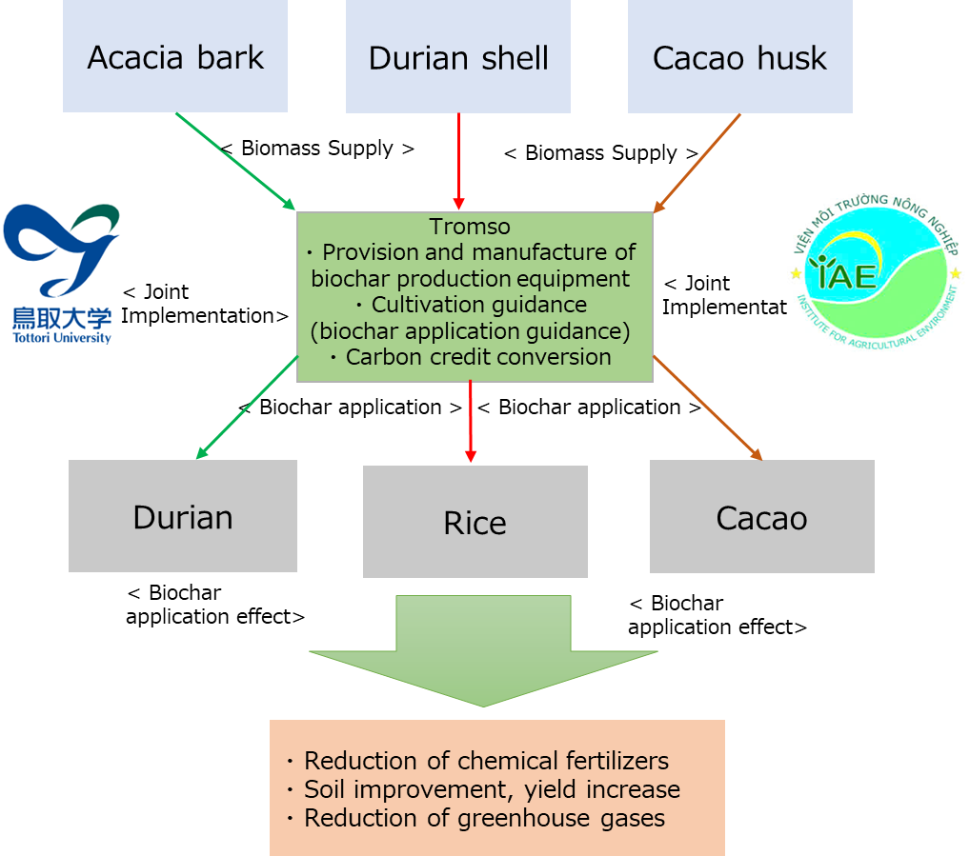
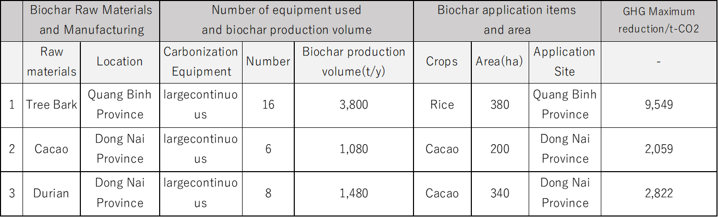
Global South Future-Oriented Co-Creation Project (Large-scale Demonstration ASEAN Member States)
Business Overview
Cultivation test plan by biochar application
by this project
・Acacia (Prince HD Company, Binh Dinh Province)
・Rice (Quang Binh Province)
・Cacao (Dong Nai Province, Trong Dak Company)
・Durian (Dong Nai province)

Slide 13
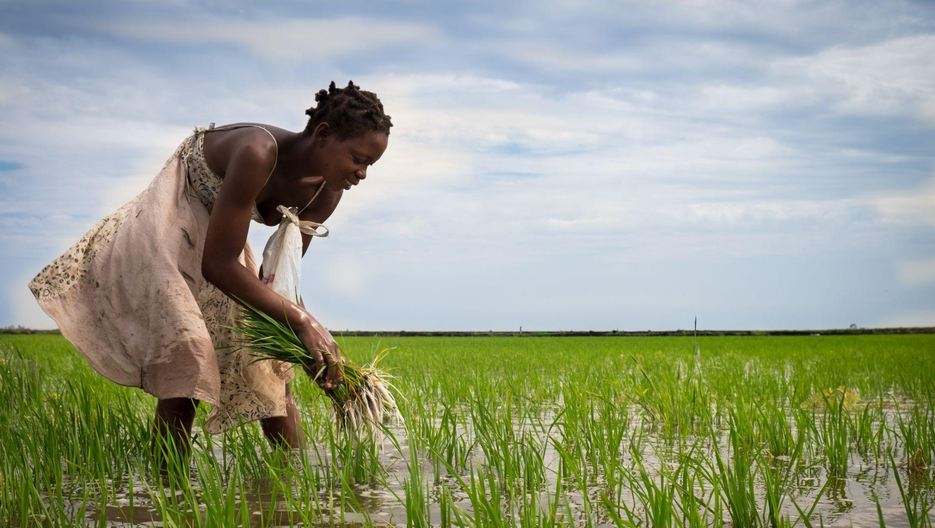
Tromso's Aim for the Future
Future
Tromso, through its "Protects greenery" business
and "Nurtures greenery" business
Creating a circular society that improves the lives of people around the world, starting from Tromso
© Tromso Co., Ltd.

