Slide 1

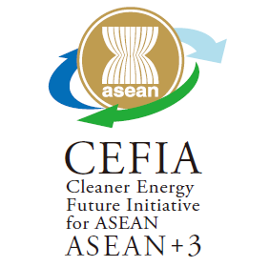
Overview of CEFIA
（Cleaner Energy Future Initiative for ASEAN）
12 May 2026
SUMITOMO Yojiro
Global Environmental Affairs Office
Ministry of Economy, Trade and Industry, Japan

Slide 2
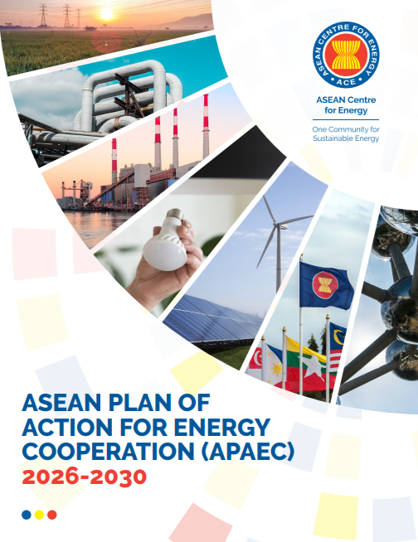
About CEFIA
CEFIA (Cleaner Energy Future Initiative for ASEAN) is a public-private initiative for the introduction of clean energy such as energy conservation and renewable energy in the ASEAN region. In September 2019, Japan proposed this initiative and its establishment was welcomed at the 16th ASEAN+3 Energy Ministers Meeting.
Under CEFIA, ASEAN countries will promote the development of a clean energy-related business environment in the region through the implementation of energy efficiency and renewable energy (flagship projects) in collaboration with the public and private sectors.
CEFIA's activities are reported and discussed at the annual CEFIA Public-Private Forum. Progress is reported to the ASEAN+3 Energy Ministerial Meeting every year.
Japan will also collaborate with the Asian Zero-Emission Community (AZEC), which it leads to promote decarbonization, economic growth, and a stable energy supply in Asia.
9 CEFIA forums have been held to date.
ASEAN Energy Action Plan
ASEAN Plan of Action for Energy Cooperation (APAEC) 2026–2030
Joint Statement of the 3rd AZEC Ministerial Meeting Kuala Lumpur, October 17, 2025
“ASEAN has made significant strides in enhancing the participation of the private sector and financial institutions, particularly Energy Service Companies (ESCOs) and industry clusters, in promoting EE&C. Private sector participation through business forums and matchmaking for EE&C projects occurs via platforms such as the Cleaner Energy Future Initiative for ASEAN (CEFIA) Forum, facilitating dialogue among policymakers, financiers, and practitioners, and fostering investment and business growth in clean energy projects.”
Public-Private Cooperation
We welcome the activities done by the AZEC Advocacy Group, led by the ASEAN Business Advisory Council, Japan Business Federation, and ERIA, including support to the AZEC Business Forum, which was held in collaboration with ASEAN Sparks, ASEAN Energy Business Forum (AEBF), and Cleaner Energy Future Initiative for ASEAN (CEFIA), held in the sideline of the 3rd AZEC Ministerial Meeting to serve as a significant platform for dialogue on key themes aligned with the major initiatives of AZEC.
Notes:
AZECとCEFIAの関係を丁寧に

Slide 3
About CEFIA Flagship Projects
Flagship projects are led by Japanese industry associations, private companies, and ASEAN financial institutions, and focus on the energy conservation and renewable energy sectors to develop and disseminate best practices in ASEAN.
Specifically, they conduct workshops and webinars to promote “awareness and understanding of technologies” and “the development of policies and systems for dissemination,” as well as feasibility studies (FS) and capacity building.
Name | Outline | Participating Organizations
ZEB （Zero Energy Building) | This group supports activities such as raising awareness of the ISO technical specification (TS23764), creating an environment for access to products and technologies, and materializing a demonstration project in Malaysia. | Japanese Business Alliance for Smart Energy Worldwide （JASE-W）
Hydrogen, Ammonia | Launched as a new flagship at the 7th CEFIA Forum. Promotes hydrogen and ammonia production, transportation, and co-firing and mono-firing technologies. | Japan Hydrogen Association（JH2A） Clean Fuel Ammonia Association （CFAA）
Biomass | JCOAL member companies promote biomass technologies including CFB (circulating fluidized bed) boilers suitable for biomass power generation, biomass co-firing, biomass pellets, BECCS, and biochar. | Japan Carbon Frontier Organization（JCOAL）
Microgrid | Support for efforts to introduce micro-grid systems that integrate multiple renewable energies from wind and solar power generation and storage batteries. | KRAFTIA（Former Kyushu Electric） Furukawa Battery
CCUS (forcusing on Carbon Recycling) | Conducts awareness and outreach activities aimed at building cooperative relationships with ASEAN countries to expand carbon recycling, which involves capturing and reusing CO2. | Carbon Recycling Fund
Finance | Identify the needs of local financial institutions, organize seminars, and support the formulation of financial instruments for the introduction of decarbonization technologies. | Asia-Pacific Development Finance Institutions Association（ADFIAP）
Notes:
AZECとCEFIAの関係を丁寧に

Slide 4
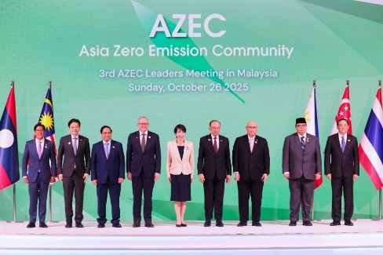

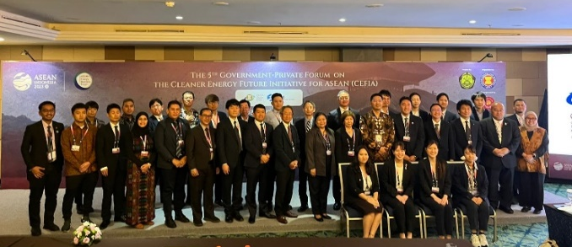
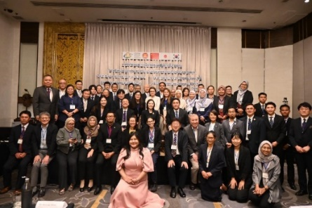
Cooperation for Decarbonization in ASEAN
Cleaner Energy Future Initiative for ASEAN (CEFIA)
Asia Zero Emission Community (AZEC)
A very flexible public-private initiative for the introduction of clean energy such as energy conservation and renewable energy in ASEAN.
Aligning with the needs of ASEAN countries.
Working to expand networks and strengthen connections with various entities within ASEAN.
Contribute to the ASEAN Plan of Action for Energy Cooperation (APAEC) 2026-2030 phase.
11 partner countries: ASEAN, Australia and Japan
Goal: To share a common objective of carbon neutrality and collaborate on a realistic transition through various pathways
540+ tangible projects
The Joint Crediting Mechanism (JCM)
Partner countries are mainly in the ASEAN.
The achieved GHG emission reductions or removals through Japanese technology and finance will be shared as JCM credits between the partner countries
32 partner countries and 300＋ JCM projects
5th CEFIA Forum
August 25, 2023
Bali, Indonesia
6th CEFIA Forum
July 23, 2024
  Bangkok, Thailand

Slide 5
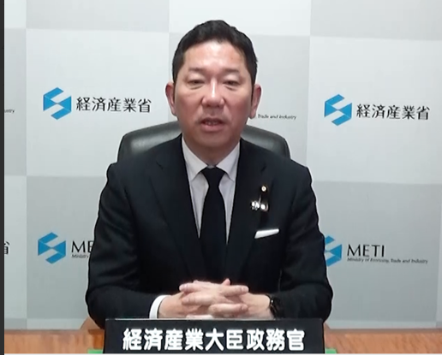
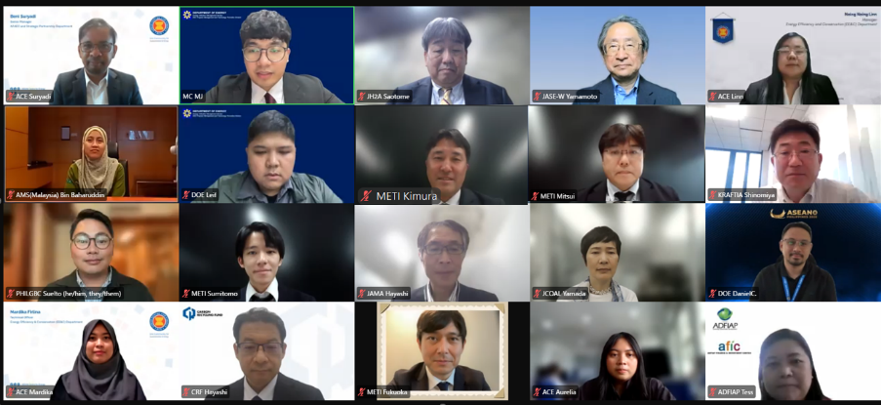
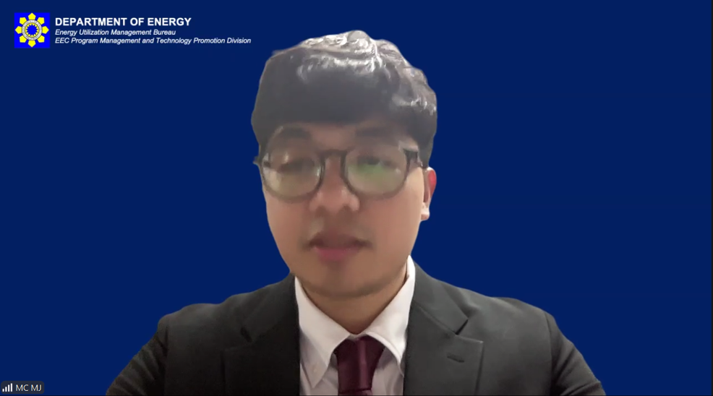
Summary of the Recently Held 9th CEFIA Forum
On April 22, 2026, the 9th CEFIA Forum was held online, hosted by the Philippine Department of Energy (DOE), with participants from governments, businesses, financial institutions, and other relevant organizations in Japan and ASEAN.
At the outset, Parliamentary Vice-Minister Toshiyuki Ochi delivered a video message, highlighting the importance of clean energy for a stable energy supply and the need to expand cooperation in Asian. He stated that Japan would promote decarbonization in Asia through initiatives such as the Asian Zero-Emission Community (AZEC) and CEFIA.
Companies and industry associations that have focused on promoting clean energy in ASEAN under CEFIA reported on the progress and future plans for specific cooperation projects (ZEB, biomass, microgrids, hydrogen and ammonia, and finance). They also launched CCUS (carbon recycling) as a new flagship project. Japan’s technologies and initiatives, such as offshore wind power and sustainable fuels, were introduced.
Finally, representatives from seven ASEAN countries introduced priority areas and policies in light of the current energy situation. Recognizing that the realization of a resilient energy structure and the further promotion of renewable energy and energy conservation are essential, they engaged in lively discussions regarding the future direction and contributions of CEFIA.
Event Overview
Opening Attendees
Participants
Date and Time: Wednesday, April 22, 2026, 3:00 PM – 7:30 PM
Organizers: Department of Energy of the Philippines, ASEAN Centre for Energy (ACE), Ministry of Economy, Trade and Industry
Format: Online
Opening Remarks:
METI: Toshiyuki Ochi, Parliamentary Vice-Minister;
ACE: Razib Dawood, Executive Director
DOE, Philippines: Felix William B. Fuentebella, Undersecretary
Speakers: 24
Online participants: 223
(Number of pre-registered participants: 330)
Program
Opening
Session 1: Initiatives of Existing Flagship Projects
Session 2: Exploration of New Flagship Candidates and Emerging Technologies
Session 3: Panel Discussion with Representatives from ASEAN Countries and METI
Closing
  Host Country / Moderator
  Philippine Department of Energy
  (DOE)

