Slide 1

IHI’s Biomass Firing Technologies and Solutions toward a Low-Carbon Society
Biomass Seminar organized by JCOAL
12th May 2026
IHI Corporation
PT IHI POWER SERVICE INDONESIA
Basic Design Gr. Life Cycle Management Dept.
Carbon Solution Business Unit
Resources, Energy & Environment Business Area
JL. Raya Bojonegara-Salira, Argawana
Puloampel, Serang, Banten, Indonesia 42454

Slide 2
Table of Contents
Introduction of IHI Corporation and IHI Group
Indonesia Government & Utility Biomass Policies
Biomass (Co-)Firing Technologies
Design Consideration for Biomass (Co-)Firing

Slide 3
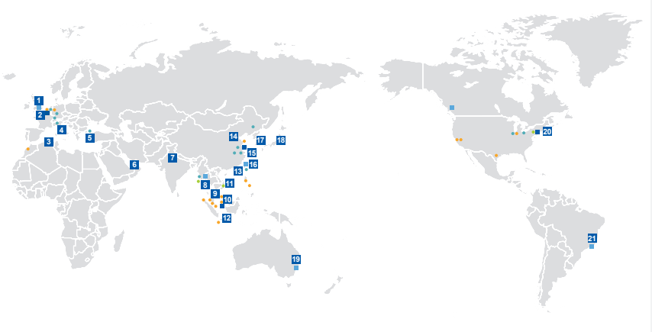
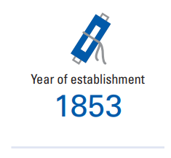
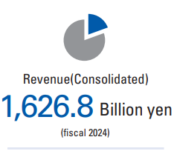

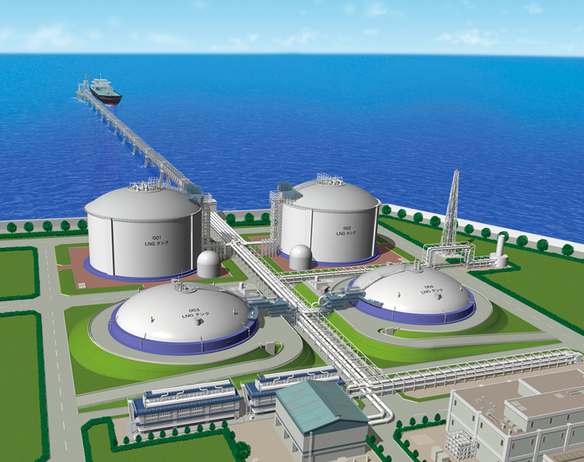
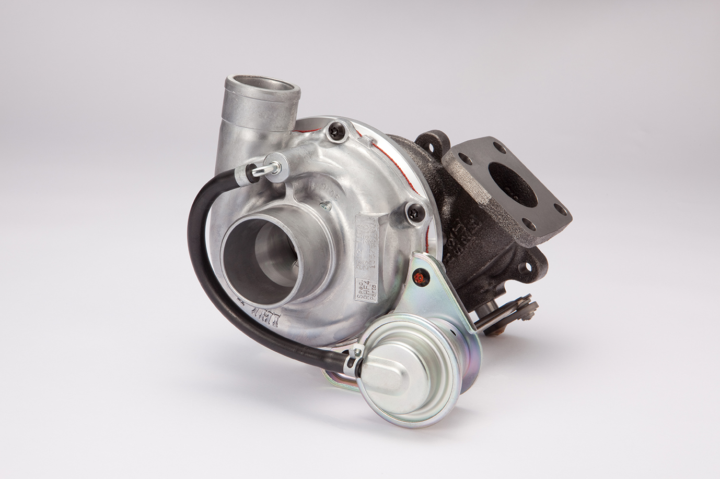
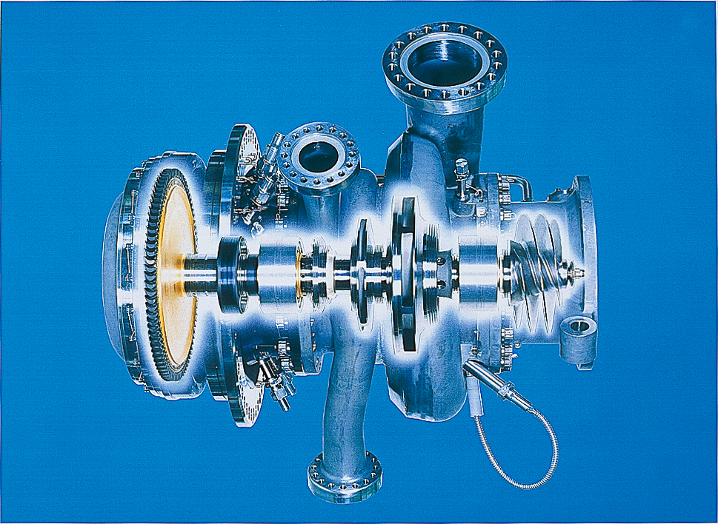
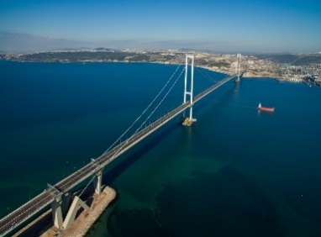
1. Introduction of IHI Corporation
IHI is a global company with 30 overseas bases and presence in 22 countries
Domestic base
4
Areas of expertise
Resources, Energy &
Environment
Industrial Systems &
General-Purpose Machinery
Aero Engine,
Space & Defense
Social Infrastructure

Slide 4

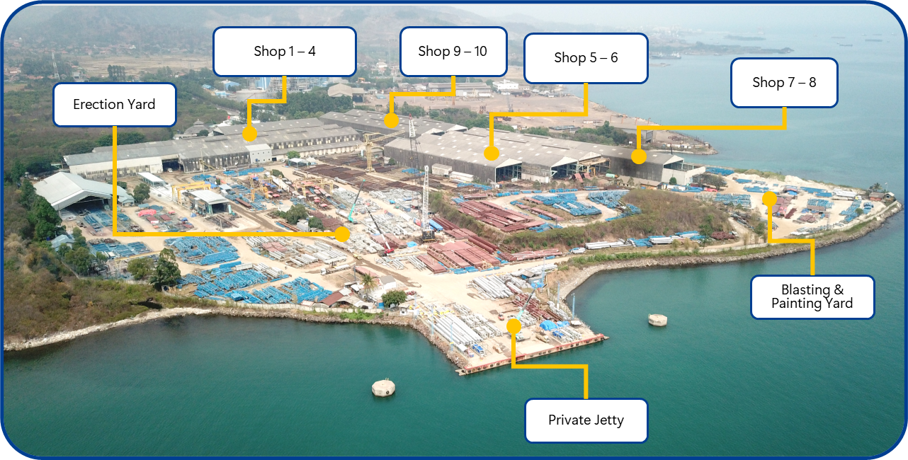
1. Introduction of IHI Power Service Indonesia
Overview of PT IHI Power Service Indonesia (IPSI)
Company Name: PT IHI Power Service Indonesia
Shareholders: IHI(88.76%), Jurong Engineering Limited(11.24%, IHI Gr company)
Date of Incorporation: 17 March 1984
Services: Steel Structure & Heavy Equipment, Boiler Pressure Parts, Piping,
Static Equipment, Life Cycle Business.
Location: Banten, Indonesia
(approx.100km west from Jakarta)
Pressure Parts ((6 Shops)
Boiler, Piping, HRSG, Pressure Vessel, Static Equipment, Maintenance Work.
Facilities :
tube panel welding, automatic panel membrane, panel
bender, facing, swaging, expanding, finning, HT furnace,
RT chamber, etc.
Non-Pressure Parts (4 Shops)
Steel Structure, Container Crane, Stacker Reclaimer, etc.
Facilities :
CNC cutting, drilling machine, rolling machine,
bending machine, etc.
Land Area：250,000㎡
Factory Area：50,000㎡

Slide 5
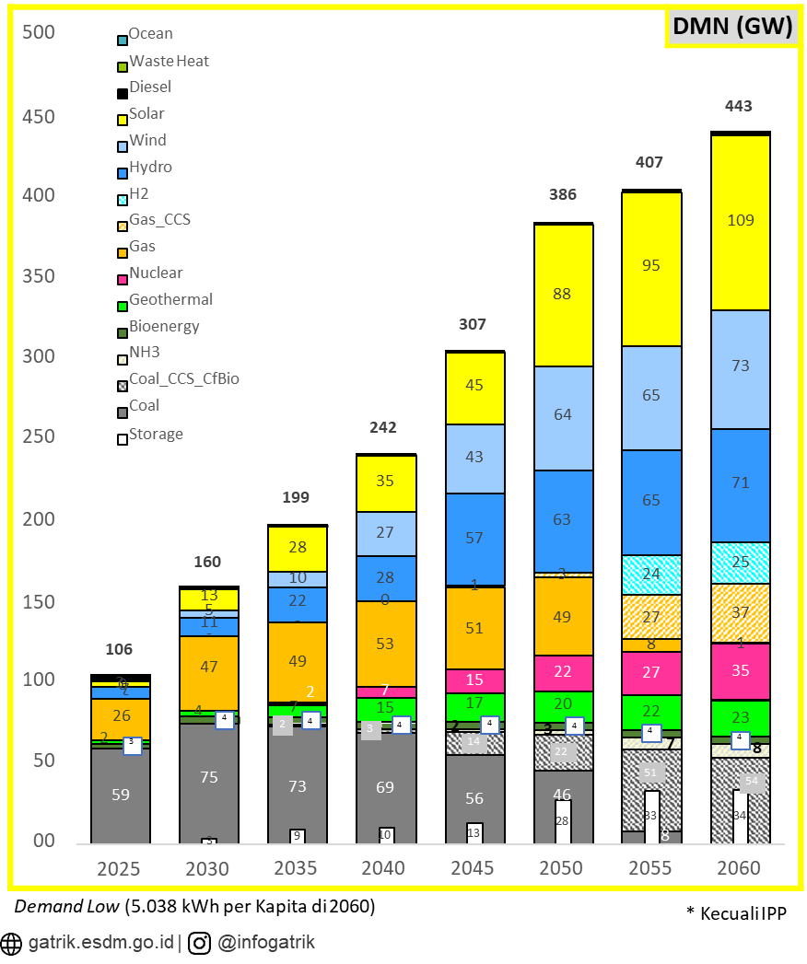
2. Indonesia Government & Utility Biomass Policies
Government Policies
RUKN 20224-2060:
In 2026 targeting PLTU Cfbio+CCS 12,2% of 443 GW demand.
MEMR Regulation No. 12/2023 _Article 5:
The utilization of Biomass Fuel for power plants as referred to in Article 2 for PLTU is implemented through Biomass Co-firing.
Biomass Co-firing as referred to in paragraph (1) is carried out by the Biomass Co-firing executors.
PT PLN Persero
Electricity Supply Business Plan RUPTL 2025-2034:
One of the strategy to reduce greenhouse gas emissions through Accelerated Renewable Energy Development (ARED) is carried out with Biomass Co-firing.

Slide 6


Current Status of Biomass Co-Firing in Indonesia
2. Indonesia Government & Utility Biomass Policies
PLN Group 2025 Biomass Cofiring Implementation
Power Generated
1.101,59 GWh
Biomass Fuel Utilized
1.14 Mt
Power Generated
954.9 GWh
Biomass Fuel Utilized
0.97 Mt
Implemented in 25 CFPP
Actual generation remains well below the target Level
Press Release 6 March 2026¹
Press Release 7 January 2026²
https://m.jpnn.com/news/manfaatkan-biomassa-pln-indonesia-power-berhasil-tingkatkan-produksi-energi-bersih, accessed 4/14/2026;16:06PM
https://www.facebook.com/plnnusantarapower/posts/sobat-nusantara-sepanjang-tahun-2025-pln-np-telah-membuktikan-bahwa-transisi-ene/1352205580039155/ , accessed 4/14/2026;16:06PM

Slide 7
2. Indonesia Government & Utility Biomass Policies
Key Challenges (as in PLN RUPTL)
1. Technical & Operational Efficiency
Plant Efficiency Impact: Biomass co-firing can lead to a reduction in overall power plant efficiency and potential increases in BPP (Biaya Pokok Penyediaan / Basic Cost of Generation).
Technical Limits: Current implementation is successfully tested at a max 5% biomass co-firing
Future Requirements: 10%–20% ratio requires further testing and likely additional capital investment (CapEx) for boiler modifications and specialized handling systems.
2. Feedstock Supply & Sustainability
Security of Supply: The primary challenge is ensuring a consistent and high-volume feedstock supply to meet the massive scaling targets (10.2M tons/year).
Forest Conservation: Collaborating with the government and private sector to develop dedicated energy forests (industrial forests) to ensure biomass production does not lead to deforestation or disturb forest sustainability.
Business Eco-system Development: Necessity to prepare a robust business ecosystem, covering: Commercial Viability for suppliers, Regulatory clarity, Stakeholder cooperation.
3. Strategic Readiness
Technology Maturity: Aligning technology readiness across various power plant types (PLTU) to ensure co-firing can be implemented nationwide.
Logistical Infrastructure: Building the supply chain infrastructure required to move large volumes of biomass from production sites to power plants.

Slide 8
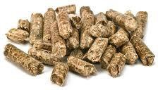
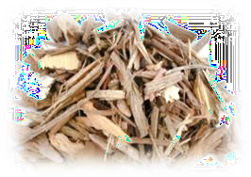
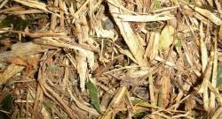

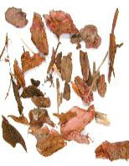
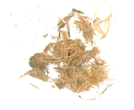
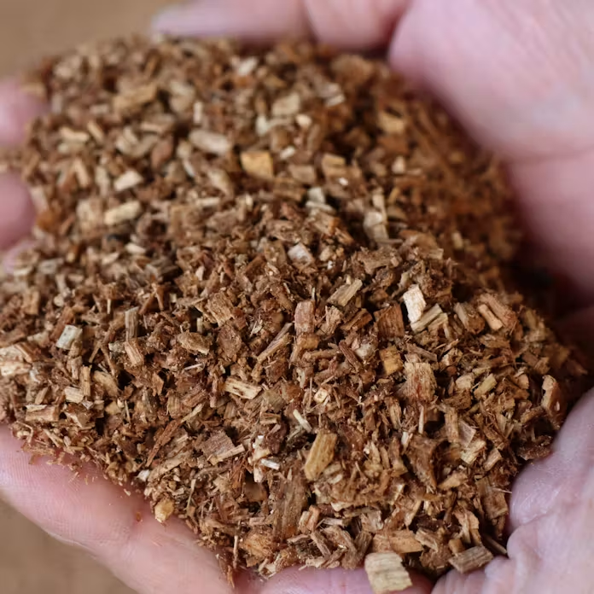

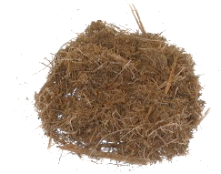
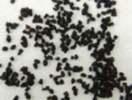
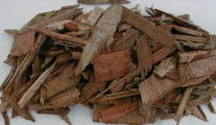
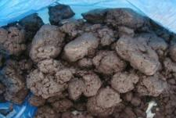
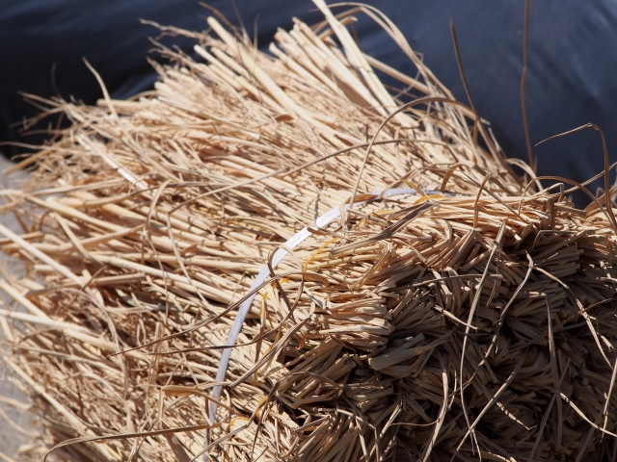
3. Biomass (Co-)Firing Technologies
Biomass Fuel Type
Easy to handle in
pellet form
Woody Pellet
16.7MJ/kg, 10%
Woody Chip
11.7 MJ/kg, 45%
Biomass type
LHV, Moisture (Typical)
Various shape
Pruned Wood
8.0 MJ/kg, 43%
LHV: Lower Heating Value (as received base)
WOODY
Bark
7.4 MJ/kg, 52%
Palm Waste
14.6 MJ/kg, 10%
Bagasse
6.9 MJ/kg, 49%
High moisture
Low Calorific value
Sawdust
11MJ/kg, 42%
WASTE
Coffee Grounds
8.8 MJ/kg, 60%
High moisture
Including Chlorine and foreign matter such as nails etc.
AGRICUL
TURAL
Waste Wood
13MJ/kg, 25%
Rice Husk
14 MJ/kg, 11%
High moisture Low Calorific value
Paper Sludge
2.6 MJ/kg, 64%
Rice Straw
13 MJ/kg, 15%

Slide 9
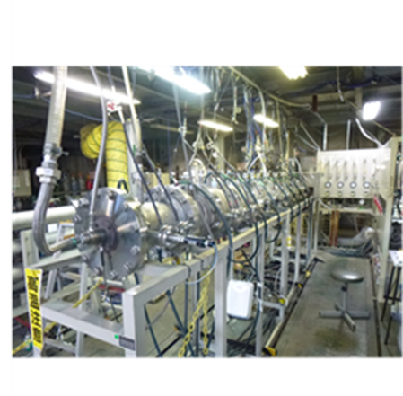
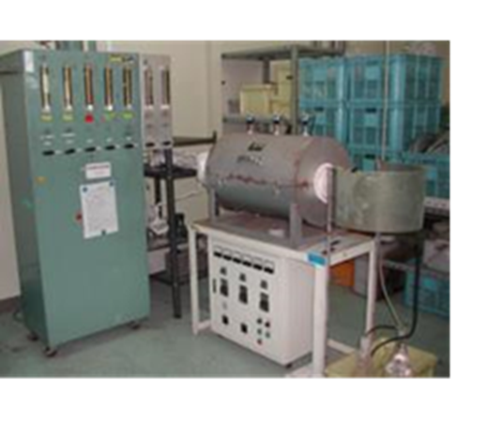
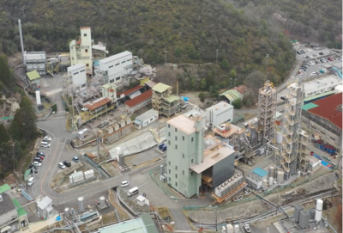
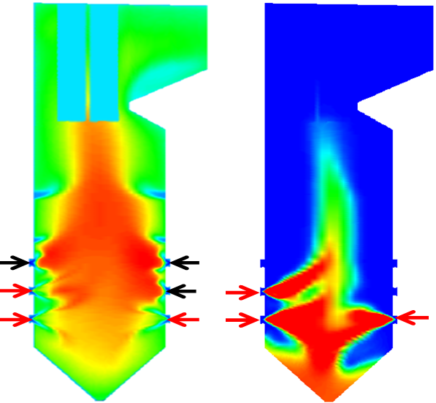
3. Biomass (Co-)Firing Technologies
IHI Development of Technology related for Biomass (Co-) firing.
The following items are the major considerations for biomass firing.
 | Items to be evaluated | Tools / Test Facilities
① Pulverizer | Grindability / Particle size Drying of wet biomass Material balance (heat / air flow) | - Labo. scale grindability Test facility - IHI Combustion Test facility - Ash Test facility for slagging/fouling - Ash Test Facility for corrosion - Flow simulation (CFD) - Actual burn at Power station
② Burner | Combustion performance - NOx/CO - Unburned biomass
③ Boiler | Thermal performance at heating elements Ash troubles (slagging/fouling/corrosion) GAH performance
IHI Combustion Test Facility
Ash Test Facility
Ash corrosion Test Facility
CFD

Slide 10
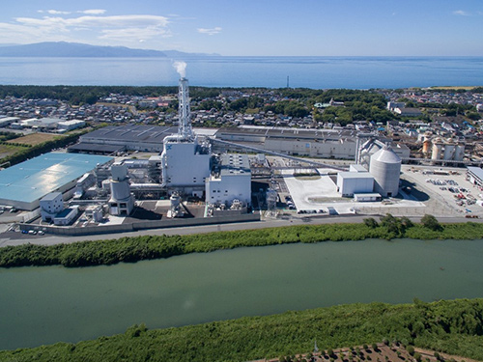
3. Biomass (Co-)Firing Technologies
IHI Biomass (Co-) firing Power Plants
Modification for existing coal firing boiler / Newly construction
Various Co-firing rate
Achieved dedicated-firing with modification
Received an order for the conversion to woody biomass fuel of boilers for power generation
-December 04, 2019-
IHI has received an order from Suzukawa Energy Center Co., Ltd. for the woody biomass conversion work of the thermal power plant. This project is for the woody biomass conversion project promoted by Suzukawa Energy Center and will be the first woody biomass conversion work in Japan at a PC-fired boiler. Commercial operation is scheduled in summer 2022.
IHI biomass (Co-)firing power plants in Japan
Project | Output [MW] | (Co-)Firing rate [cal%] | Year
Many Ref. | - | 2~3 | 2005-Current
K | 149 | 8,25 | 2015
N | 110 | 30 | 2017
I | 149 | 25/42 | 2018/2023
O | 500 | 15 | 2020
T | 600 | 16 | 2022
S | 112 | 100 | 2022
A | 200 | 100 | 2023
NO | 700 | 15 | 2025
TK | 145 | 25 | 2025
Completed
Suzukawa Energy Center Power Station
https://www.ihi.co.jp/ihi/all_news/2018/resources_energy_environment/1190426_1616.html
https://www.ihi.co.jp/ihi/all_news/2019/resources_energy_environment/1190454_1591.html

Slide 11
4. Design Consideration for Biomass (Co-) Firing
Concept of (Co-)firing system
Mix-pulverizing system with coal pulverizer
Dedicated use pulverizing system for biomass (in particular wood pellet)
Bio
mass
Coal
Bio
mass
Coal
Feeder
Feeder
Boiler
Feeder
Feeder
Boiler
Coal
Coal
Pulverizer
Biomass
Pulverizer
Coal
Pulverizer
◆ Current system
Co-firing rate :
Max. a few % (in calorific value)
(Depends on pulverizer capacity )
◆ Developed system
Co-firing rate :
more than 15% (in calorific value)

Slide 12
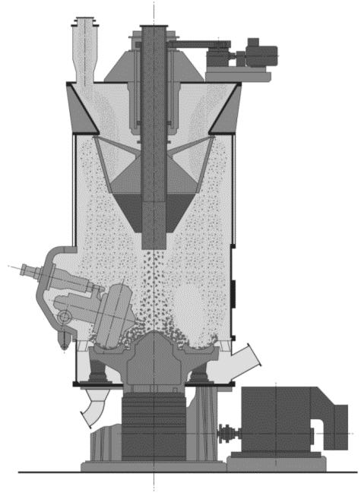
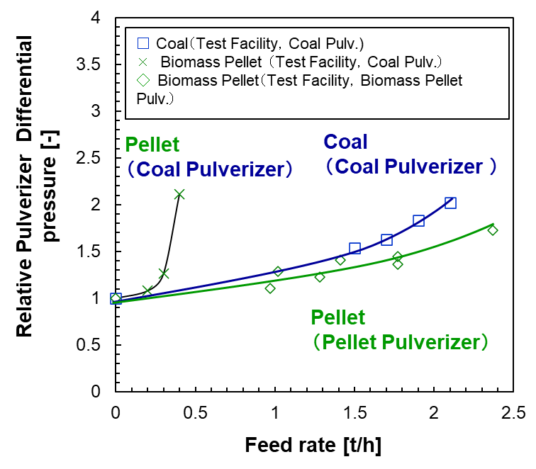
4. Design Consideration for Biomass (Co-) Firing
Grindability and Processing Capacity
One of the key issues of biomass firing is the difficulty in discharging the larger particle size of biomass from pulverizer to boiler.
In order to assist discharging the larger size of biomass IHI has developed the technology that this pulverized biomass (wood pellet) is exhausted by increasing flow velocity inside pulverizer equipped with “flow acceleration ring”.
Coal mono firing is acceptable by removing the ring.
Flow Acceleration
Ring to increase velocity
Large size biomass
requires higher terminal
velocity to be discharged
from mill.
・Biomass： 500μm-1mm
・Coal: 50μm
Coal Pulverizer
Biomass Pulverizer

