Slide 1
Introduction of
CEFIA Biomass Flagship
Japan Carbon Frontier Organization (JCOAL)
CEFIA Seminar
By the Cleaner Energy Future Initiative for ASEAN (CEFIA)
at
The 2nd Indonesia-Japan Environment Week
12 May 2026

Slide 2
Contents
Introduction of JCOAL
CEFIA Biomass Flagship Activities in Sep 2025-Mar 2026
Why Biomass and Biochar?
Biomass Utilization
Biomass is to Make Multifaceted Contribution to APAEC 2026
Plan for Apr 2026-Mar 2027
Expected Discussion Points at the CEFIA Seminar

Slide 3
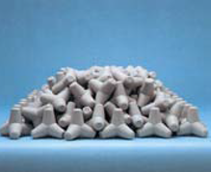
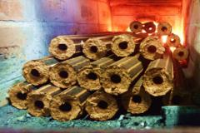
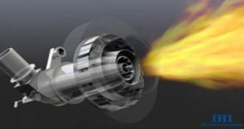
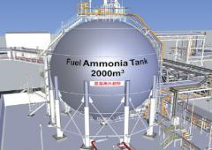
1. Introduction of JCOAL
JCOAL: A Long-standing Partner of ASEAN in the resources sector, the power sector and the industrial sector
Established in 1990, with its origin back to 1948
Deals with technologies and measures for carbon neutrality with a broad scope of work involving various energy technologies such as biomass, ammonia and hydrogen utilization, and carbon recycling in addition to all coal related issues from upstream to downstream of the coal value chain.
The unique team with engineers and analysts covering a broad range of areas enables well fabricated advisory and consultancy work that is deep-rooted in engineers' spirit.
JCOAL embraces a membership system, under which 149 domestic/international organizations and companies get together. They may work together with JCOAL in pursuit of decarbonization.
JCOAL is a DP of ACE since 2009.
Technologies for energy transition & the future carbon neutrality
Captured CO2
CO2
Coal Ash Utilization
Biomass Co-firing
Carbon Recycling
十
H
e-methanol
Ammonia Co-firing
Source: Edited by JCOAL based on information in the public domain

Slide 4
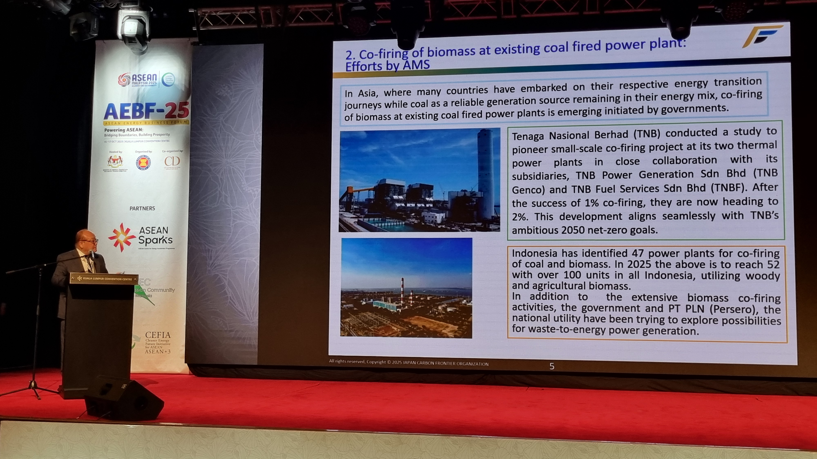
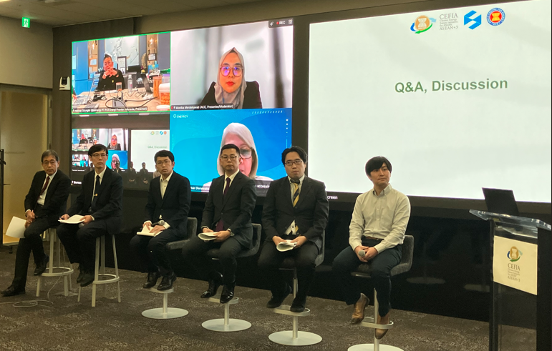
2. CEFIA Biomass Flagship Activities in Sep 2025-Mar 2026
Sep 2025
JCOAL was appointed to undertake CEFIA Biomass Flagship
Oct 2025
JCOAL participated to speak at the 8th CEFIA Forum
Jan 2026
CEFIA Flagship Biomass Webinar
8th CEFIA Forum in Kuala Lumpur, Malaysia
Source: CEFIA Digital Platform
Constituted by presentations on biomass firing and biochar utilization technology and relevant policy updates as well as on-going efforts and perspectives by utility, CEFIA Biomass FP Webinar tried to share ASEAN-applicable, Japan-initiated biomass technology and supporting policy information. Presentation and the following discussion in the form of Q&A were intended to enhance and ensure the trust from ASEAN utilities and relevant institutions toward such technology.
CEFIA Flagship Biomass Webinar
Source: JCOAL
2

Slide 5
3.-1 Why Biomass and Biochar?
Biomass
Biomass is renewable and inherently carbon-neutral, derived from biological resources such as plants, animals, and other living organisms and municipal wastes. Biomass has come to be re-emerging while countries are trying hard to go their respective transition pathways, for the features such as renewable nature, geographical diversity and availability.
Carbon Credit Generation
Indigenous Resources Utilization
Competitive in terms of Handling & Calorific Values
Defined as carbon neutral
Conducive to Local Community Development
Serves as Non-VRE Resources for Power Generation
Possible to Serve as Export Product
Source: JCOAL

Slide 6
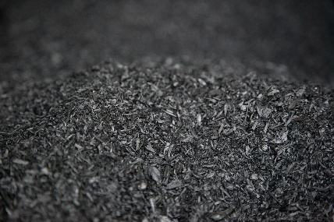
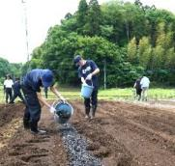
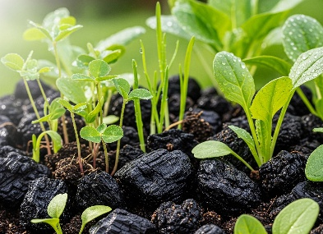
3.-2 Why Biomass and Biochar?
Biochar
Biochar is a porous, carbon-rich (70-80%), black, solid, fine-grained structure prepared through the thermal breakdown (300-850℃) of agricultural wastes in which oxygen is absent or depleted. Biochar is also a valuable material for agriculture, carbon removal and storage, land-use challenges, remediation, and economic development.
Key benefits of biochar
Carbon Fixation (CF)
Pyrolysis chemically transforms the carbon in biomass more stable.
High-quality biochar made through controlled, high-temperature pyrolysis,
are more stable and effective at locking up carbon.
Environmental Protection
Through sorption, biochar can decrease atmospheric
ammonia emissions, limit nitrate leaching and runoff,
decrease phosphate pollution and remediate contaminated soils effectively.
Improve soil water properties
Biochar is highly porous at multiple scales, giving it a vast pore volume.
This structure can absorb significant amounts of water and dissolved nutrients within. Biochar can improve the water-holding capacity of soils that plant available water by up to 28.5%.
Wikipedia
Sakura Municipal Office
Indochar.org

Slide 7
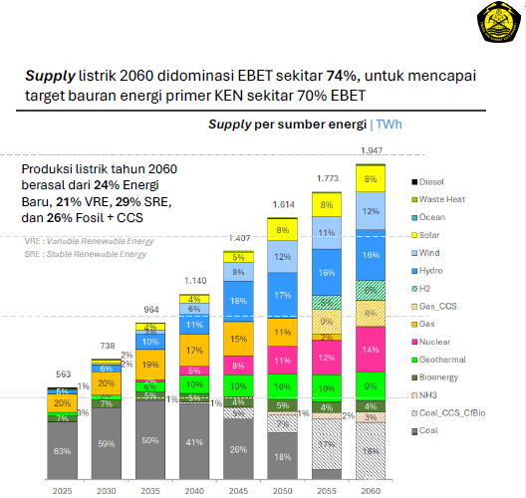
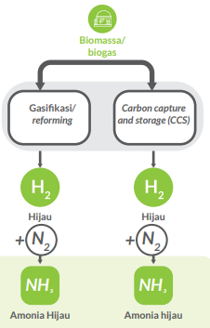
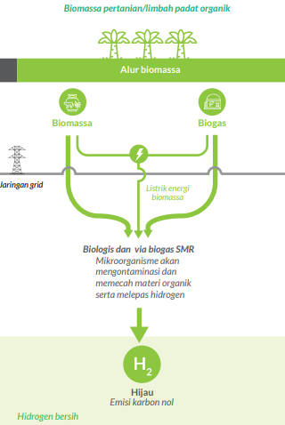
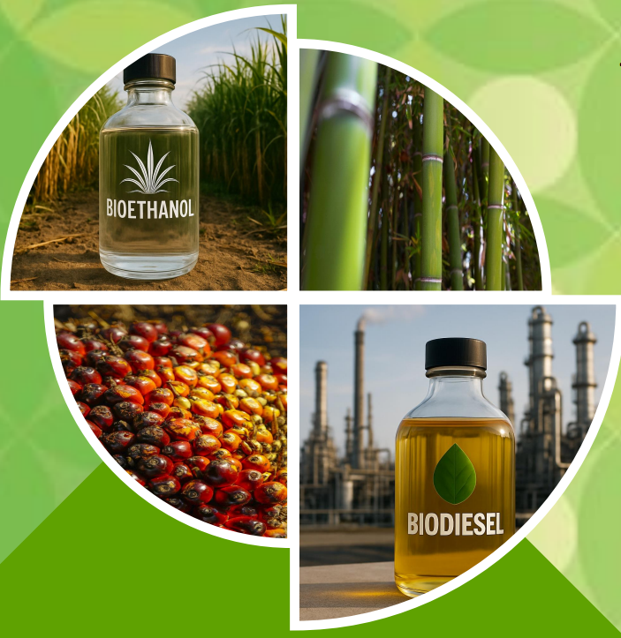
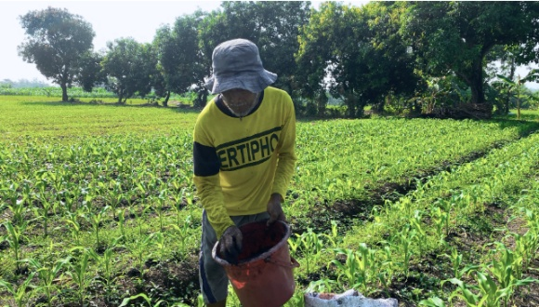
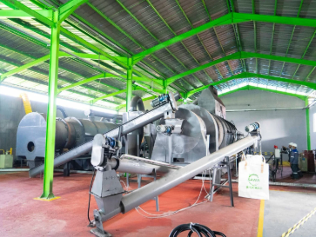
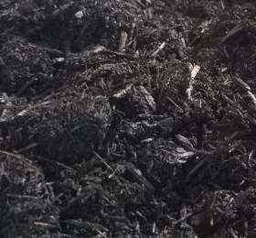
4.-1 Biomass utilization as a part of decarbonization strategy of Indonesia
Green Hydrogen & Green NH3 Production
In 2025 Biomass-based generation capacity was supposed to reach 39.4 TWh.
In 2050 it will be doubled to be 77.9 TWh.
NH3
H
Biofuel
Biochar
Source: APROBI (2026)
Offset8
Capital
Waste-X
Source: PETA JALAN (ROADMAP) HIDROGEN DAN AMONIA NASIONAL,
EBTKE (2025)
Antara

Slide 8
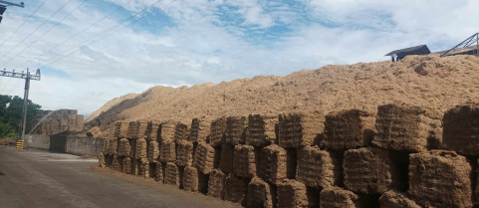
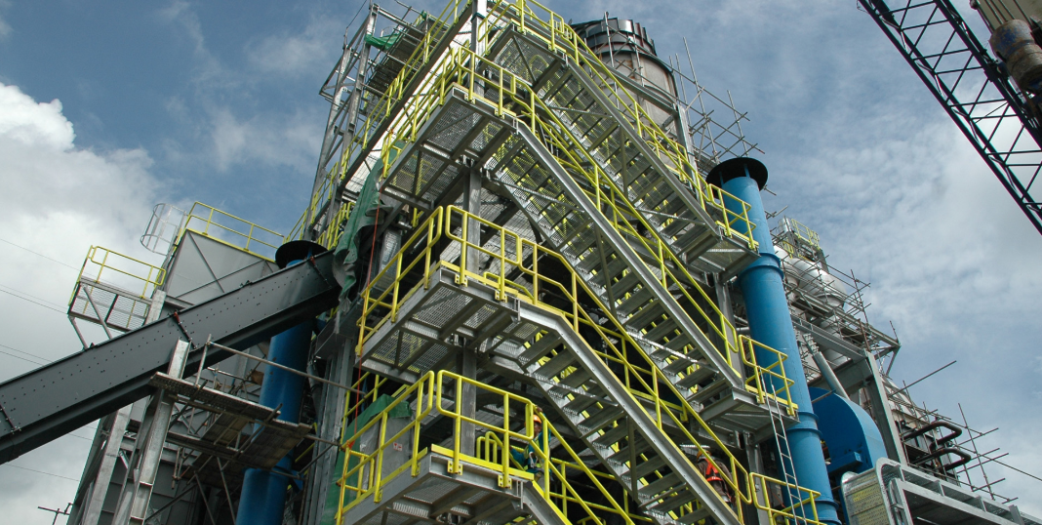





4.-2 Biomass utilization: Sustainable agricultural business development
in the Philippines: The case of Biotech FARMS
Agricultural sector in the Philippines contributes to GDP by 9.4%, while employment in agriculture remains over 20% of the total labor force.
DOE targets at min. 277 MW of additional biomass power capacity by 2030. the Biomass Renewable Energy Alliance (BREA) says Philippines could tap 4.7 GW
“Sustainability from Farm to Plate
with Circular Economy”
Biotech FARMS engages in grain, sugar, and swine industries.
They utilize agricultural by-products in well-designed circular mode.
Bagasse Stockpiling
Source: Biotech FARMS
By Biotech FARMS
Steam + Power
Source: Edited by JCOAL based on information from OECD, The World Bank, Philippine Statistics Authority, and Biotech FARMS
Biomass Power Plant of Biotech FARMS
Source: Biotech FARMS

Slide 9
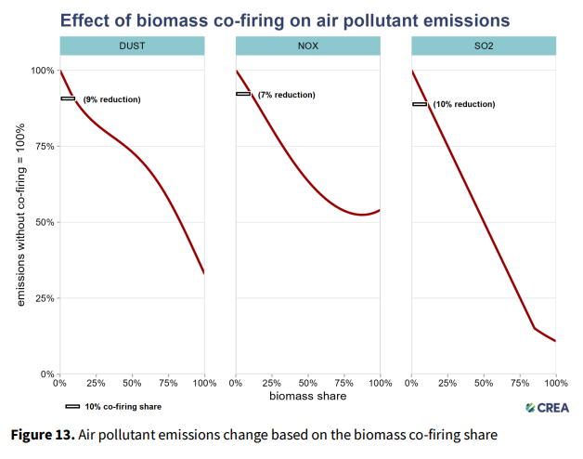
4.-3 Biomass utilization as a part of decarbonization:
Environmental measures remain important in the case of cofiring
We must note in the case of co-firing, only co-firing would not be sufficient. With less-than- 10% co-firing, very little flue gas reduction is observed. Appropriate flue gas reduction measures, as part of CCT (Clean Coal Technology) are to be taken.
Source: Centre for Research on Energy and Clean Air

Slide 10
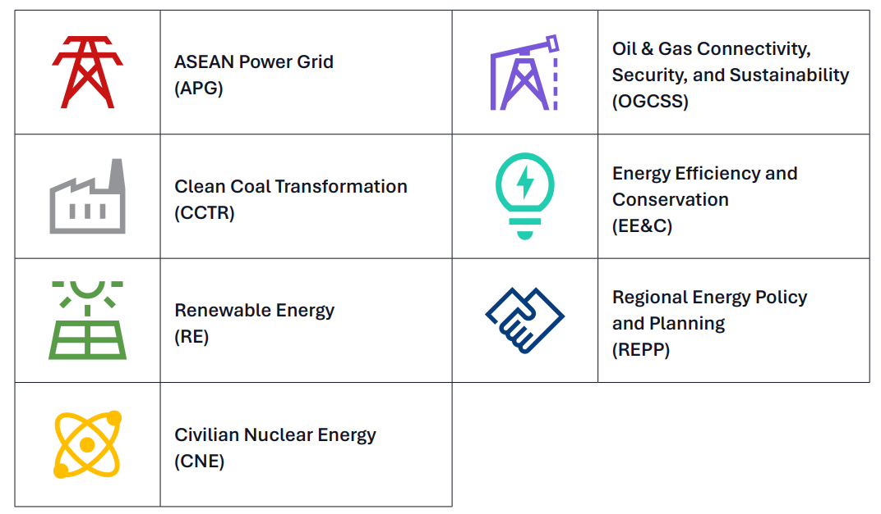
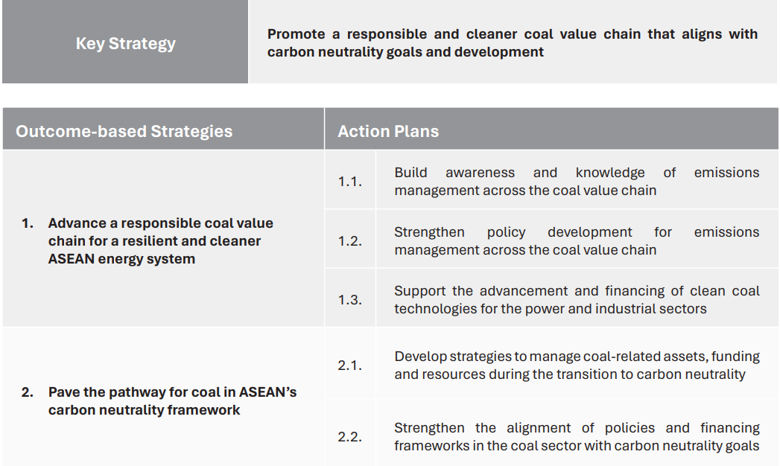
5.-1 Biomass is to make multifaceted contribution to APAEC 2026
ASEAN is to advance an affordable, just, and low-carbon energy transition
Introducing biomass for cofiring or dedicated biomass firing by fuel conversion will help emission management at the concerned plant and related coal value chain
Introducing biomass for cofiring or dedicated biomass firing is a part of advancing efforts with clean coal technologies for the power sector and the industrial sector

Slide 11
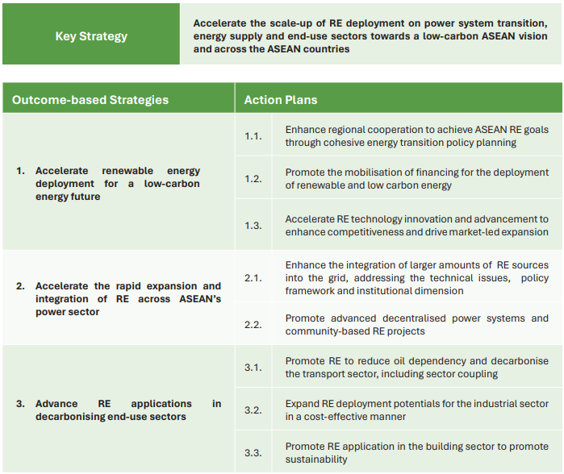
5.-2 Biomass is to make multifaceted contribution to APAEC 2026
Biomass is to contribute to grid stability enhancement by serving as non-VRE clean energy and dispatchable resources
Biomass has high potentials for the industrial sector as well as for the agricultural sector
Source: ASEAN Plan of Action for Energy Cooperation (APAEC) 2026
4

Slide 12



6. Plan for Apr 2026-Mar 2027
22 Apr 2026 ONLINE
11-12 May 2026 HYBRID
Keep updating ASEAN and Japan stakeholders throughout
Apr 2026-Mar 2027,
to facilitate actions toward project implementation
Autumn 2026 ONLINE
CEFIA Flagship
Biomass Webinar

Slide 13
7. Expected Key Information and Discussion Points at the CEFIA Seminar
Topic 1. Biomass Utilization Promotion
What are issues to be addressed in expediting biomass co-firing and conversion to dedicated biomass firing?
Whether incentives for biomass utilization are sufficient, and if not, what kind of incentives through deregulation/regulation are made available?
Topic 2. Biomass Supply Security
Whether biomass fuel supply as a part of the value chain is ensured, and what measures are taken to secure fuel supply?
Whether the government in its inter-ministry communication is discussing measures to materialize biomass production well integrated into the national and local ecosystem, in view of the importance of environmental sustainability?
In connection with the supply security, whether biomass supply for biofuel and that for power generation are not too much competing each other?
Topic 3. Biomass Technology Values
What are the stand-out-from-the-crowd values of technology each Japanese company can offer to Indonesia especially and other AMS?
What do you expect to Japanese companies in working together for decarbonization through biomass utilization?

Slide 14
We look forward to continuously working with you
Japan Carbon Frontier Organization (JCOAL)
Website: https://www.jcoal.or.jp/eng/
Email:
takeshita@jcoal.or.jp
fyamada@jcoal.or.jp
oshima@jcoal.or.jp

