Slide 1
Biomass Power and Gasification Technologies
Toward Net-Zero Society
The 2nd Indonesia-Japan Environment Week
Session 5: Cleaner Energy Future Initiative for ASEAN(CEFIA)

Slide 2
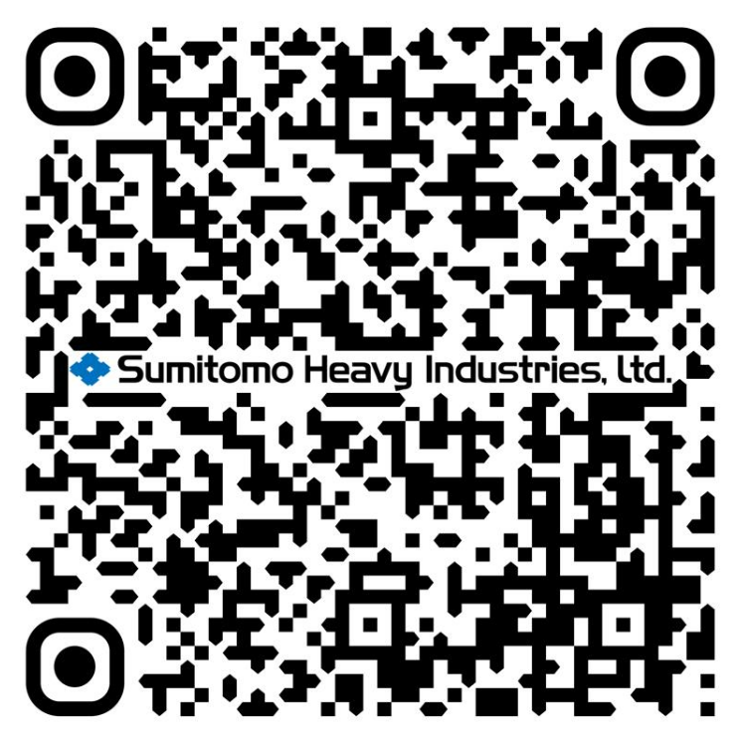
01
Brief Overview of SHI
02
Circulating Fluidized Bed (CFB) & Bubbling Fluidized Bed Boilers (BFB)
03
Fluidized Bed Gasifiers
04
Technology Modernization & Upgrade (TMU)
Please find our 2025 integrated report
(as per Dec 31, 2024)

Slide 3
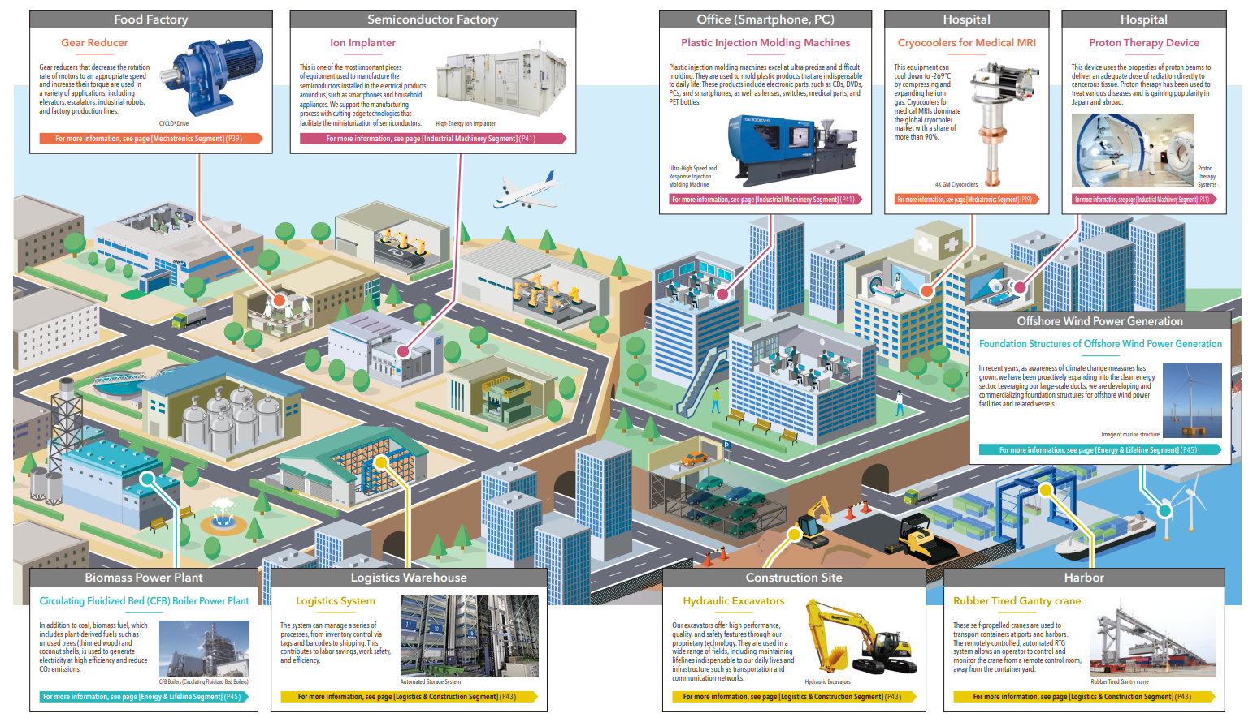
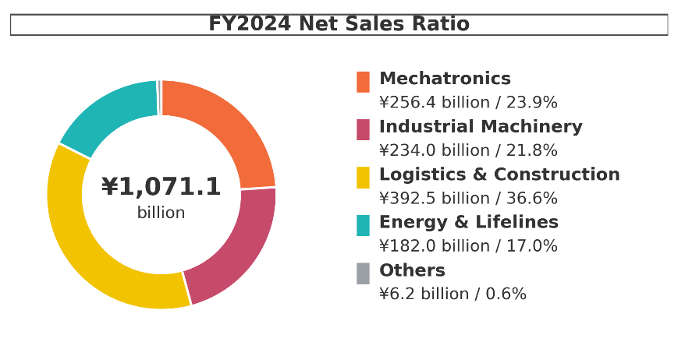
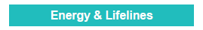
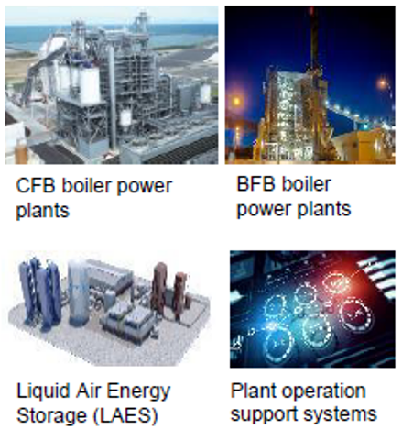
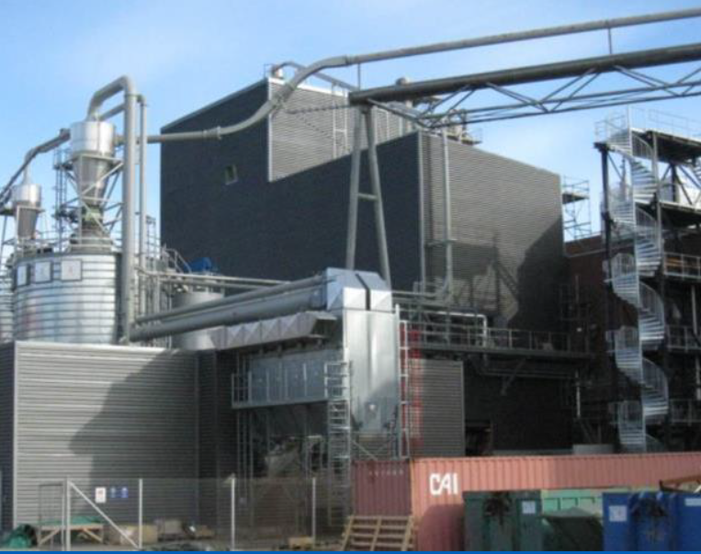
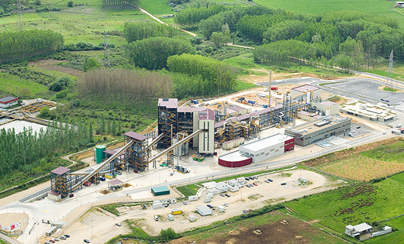
1
Brief Overview of SHI
Gasification
Carbon Capture

Slide 4













1
Brief Overview of SHI
Our product supporting net zero ecosystem
Power
H₂
Fuels / Chemicals
VRE
Variable Renewable Energy
LDES
Long Duration Energy Storage
Electrolyser
Synthesis
Waste
heat & chill
O₂
CO₂
H₂/CO
CO₂
Waste to Value
Fluidized Bed Gasifier
Or OXY fuel CFB
Carbon Capture
Emissions
Electricity grid
LNG facilities
Heavy industry
and hard to
abate sectors
Emissions
Sustainable biomass and non-recyclable fractions of bio-residues and waste
De-carbonized
Steam & Power
Biomass & Waste
to Energy
CFB / BFB

Slide 5
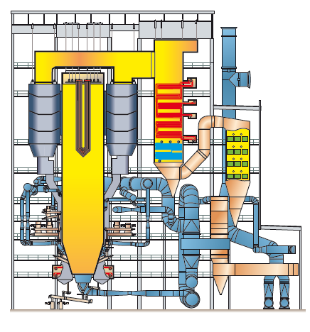
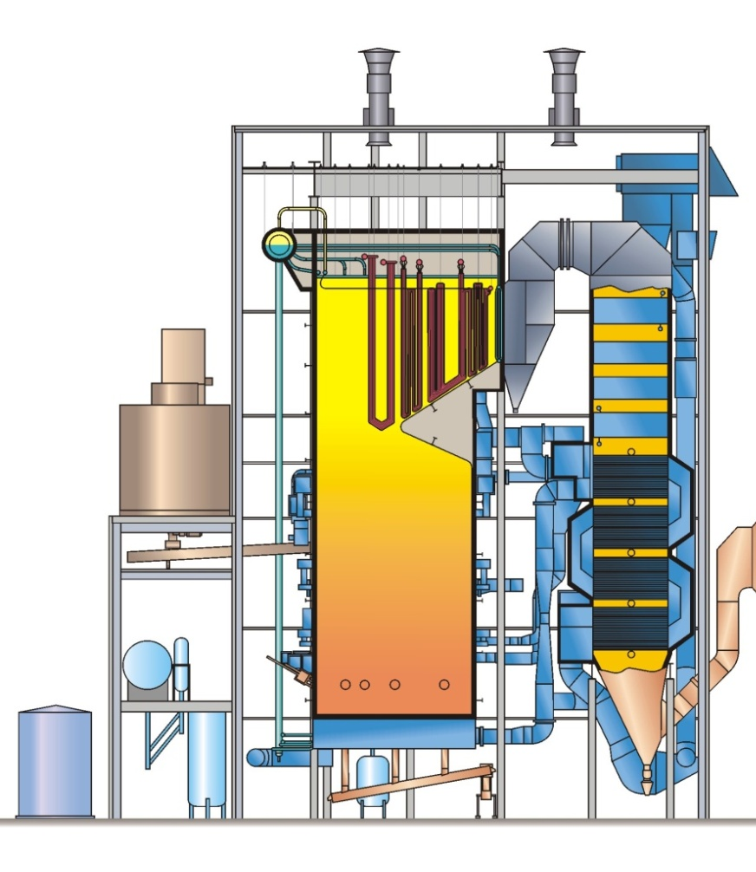
2
Circulating Fluidized Bed & Bubbling Fluidized Bed Boilers
CFB and BFB Boilers for Biomass Fuels
CFB & BFB Technology are suitable for firing wide variety of fuels including biomass and waste residues
Circulating Fluidized Bed (CFB)
Bubbling Fluidized Bed (BFB)
Unit delivered +500
Size 5~550MWe
Unit Delivered +140
Size ~100MWe
Key features of our CFB and BFB technology:
Fuel Flexibility - stable combustion over a wide range of fuels
Simple Emission Control - Very low NOx, Low CO and Sulfur Captured in Furnace
High reliability / Low maintenance - No ash slagging, which minimizes furnace corrosion and fouling

Slide 6
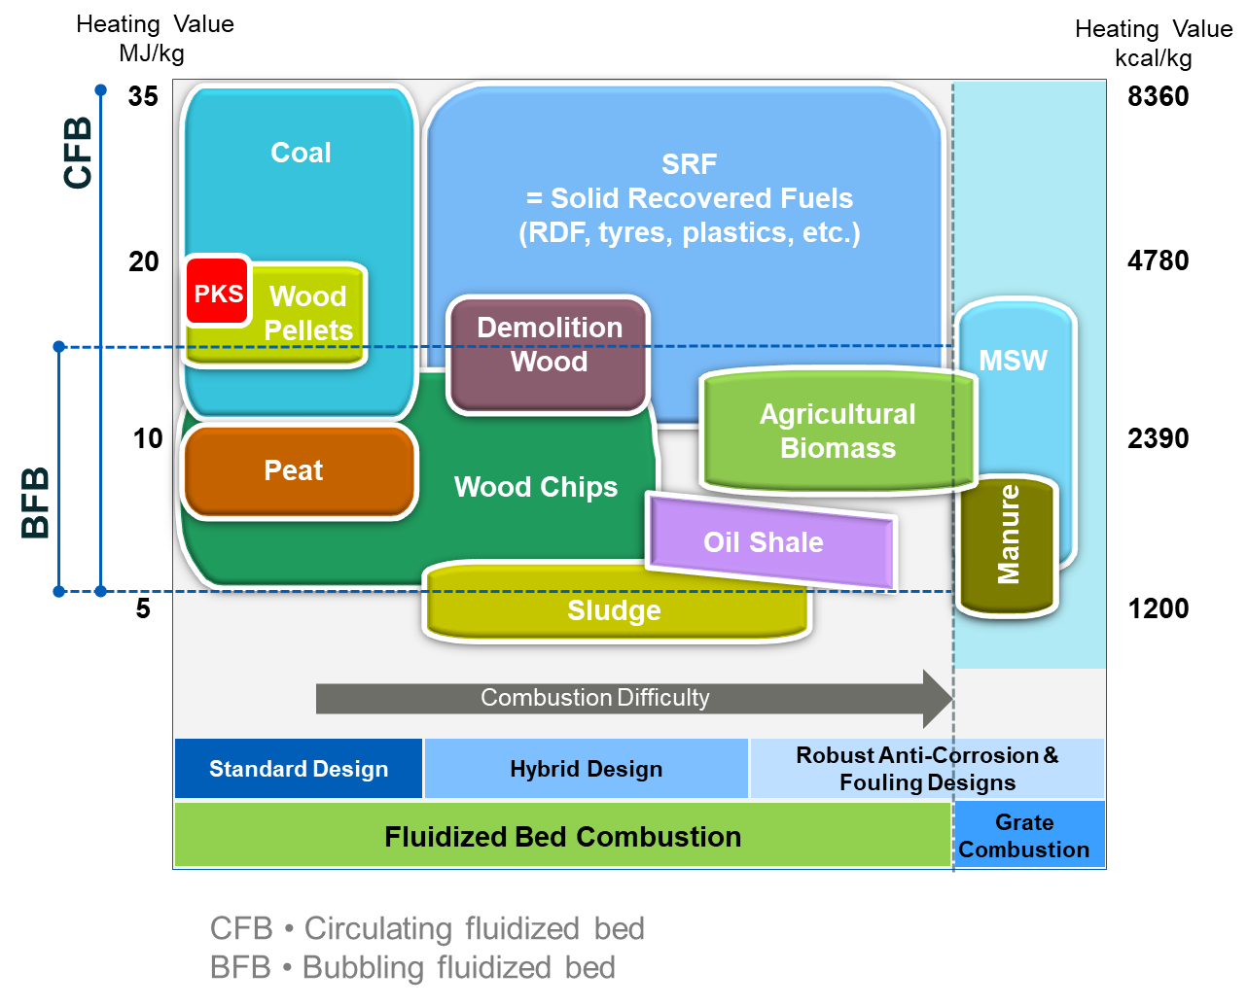
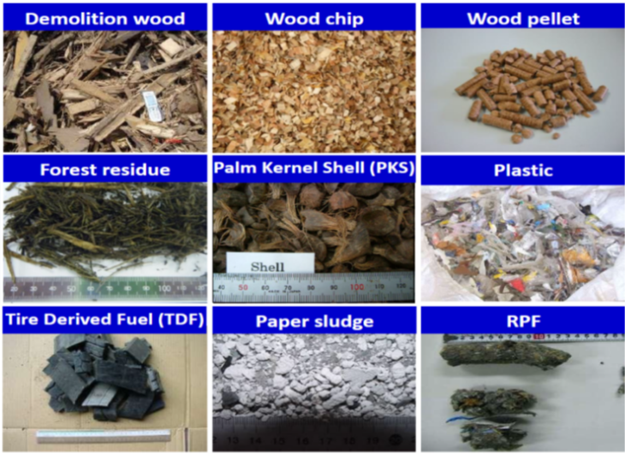
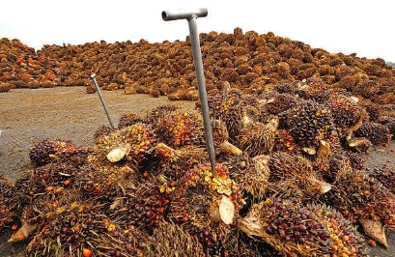
2
Circulating Fluidized Bed & Bubbling Fluidized Bed Boilers
Fluidized bed combustion technology has the widest fuel range including non-edible biomass
Demolition Wood
Wood Chip
Wood Pellet
Forest Residue
Palm Kernel Shell (PKS)
Plastics
Tire Derived Fuel (TDF)
Paper Sludge
Refuse Derived Fuel (RDF)
Empty Fruit Bunch (EFB)

Slide 7
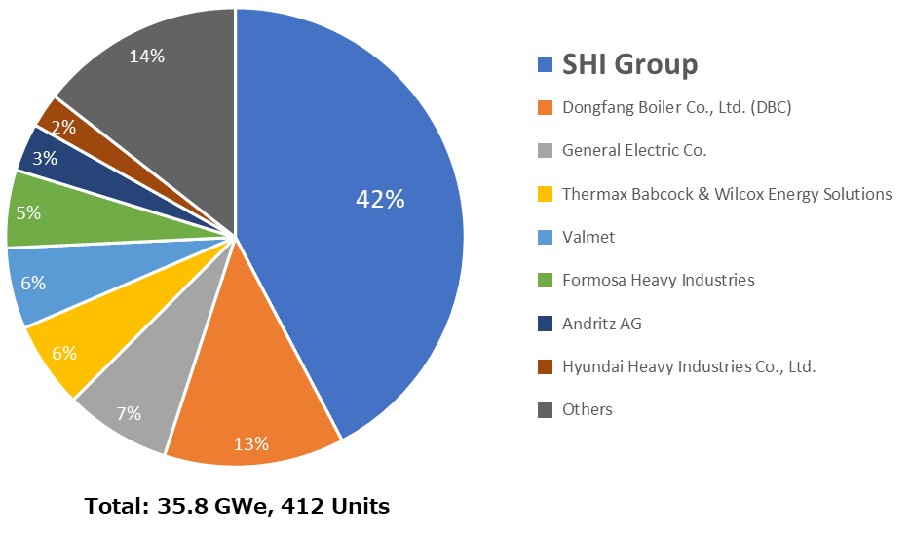
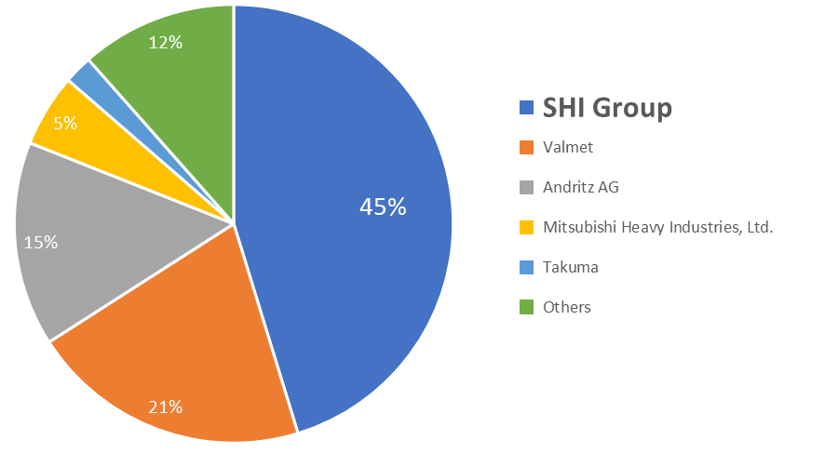
2
Circulating Fluidized Bed & Bubbling Fluidized Bed Boilers
Global CFB Orders
All Sizes
SHI Group Served Market Over 2014 - 2023 Period
We are the global CFB market leader
Served market order over last 10 years ( 2014-2023)
SHI Group has supplied 540 Circulating Fluidized Bed (CFB) steam generators from 1975 - Today
Totaling 43 GWe in power capacity
3 GWe Supercritical Once-Thru units
37 GWe of Natural Circulation units
Single unit capacities up to 550 MWe
Proven by over 50M+ hours of operation
Burning a wide range of premium and waste coals, biomass, petroleum cokes, oil shale, SRF (*)
Global Biomass CFB Orders
All Sizes
SHI Group Served Market Over 2014 - 2023 Period
(*) SRF (Solid Recovered Fuel) involve following wastes/materials;
Biodegradable waste; food and kitchen waste, green waste, paper.
Recyclable material; paper; glass, bottles, cans, metals, certain plastics, fabrics, clothes, etc.
Inert waste; construction and demolition waste; dirt, rocks, debris.
Composite wastes; waste clothing, Tetra-Packs, waste plastics such as toys, garden furniture etc.
Source: GRDS, April 18. CFB boiler type. Excludes domestic orders provided by domestic suppliers in China and India.
Licensee orders included under licensor market share. Market Share based on MWe. Biomass Fuel Types Exclude municipal solid wastes and refuse derived fuels.

Slide 8
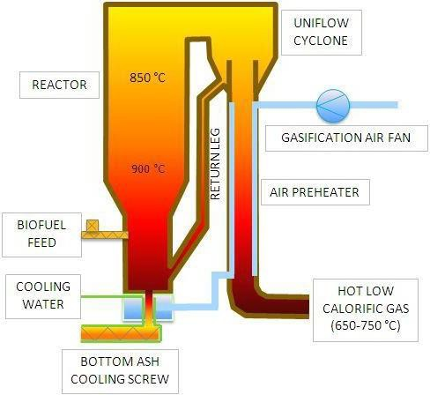

CFB Gasification Technology
3
Fluidized Bed Gasifiers
Air Gasification Technology
  Final Product → Syngas for Heat and Power
Oxy-Steam Gasification Technology
  Final Product → Ultra-clean Syngas for Chemical Process
Fluidized Bed Technology with for long particle residence times for High Efficiency even for low quality fuels
Low-temperature fluid bed gasification, the residual ash never melts, allowing the use of feedstocks considered too corrosive for other gasifiers.
Raw syngas
CO, H₂, CO₂,,,,
tars
Mix of O₂ and H₂O
* CFB = Circulating Fluidized Bed
Notes:
The most fuel-flexible gasification technology in the market.
Superior fluidized bed technology for high efficiency
Vigorous mixing and long particle residence times to efficiently gasify even the lower quality fuels.
Low-temperature fluid bed gasification, the residual ash never melts, allowing the use of feedstocks considered too corrosive for other gasifiers.
Oxy-Steam Gasification combined with and syngas cleaning system for wood-based biomass type of feedstocks produces ultra-clean syngas that can be used in the production of renewable diesel (Bio Diesel)
The Oxy-Steam Gasification technology can also be applied to convert waste to fuels and chemicals.

Slide 9

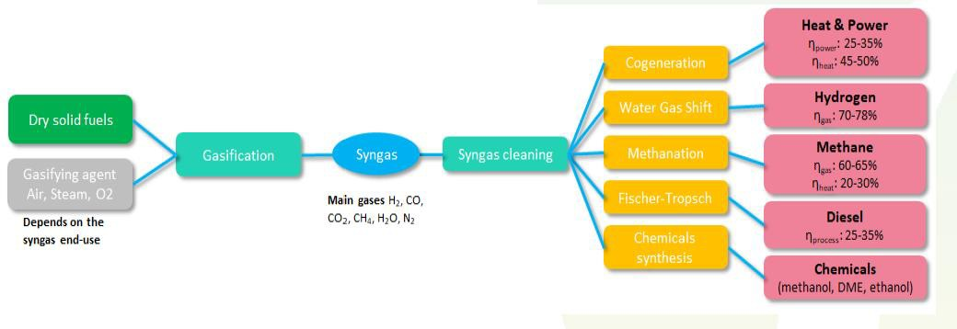
Syngas Island Supplier and Integrator
3
Fluidized Bed Gasifiers
EPC contractor and integrator
H₂ to syngas
Steam
O₂ to gasifier
Electrolyzer
Pretreatment
Feedstock pretreatment and drying; ASU
Synthesis
Focus on
SAF
Bio-MeOH RNG*
SHI
clean syngas island
SHI Direct oxy- steam CFB gasifier
3rd party technologies for catalytic (CAT) and thermal (POX) tar reforming
CO₂ & tail gas to gasifier
*RNG: Renewable Natural Gas

Slide 10
SHI’s long history with Fluidized Bed Gasification
3
Fluidized Bed Gasifiers
Our Fluidized Bed Gasifier References
Start-up | Customer | Country | MWth | Feedstock | Application
2009 | NSE Biofuels | Finland | 12 | Biomass | Biodiesel demo
2002 | Electrabel | Belgium | 60 | Biomass | Biomass co-firing
2000 | Corenso United | Finland | 60 | Plastic Waste | Recycling & Energy Recovery
1997 | Lahti Energia | Finland | 60 | Biomass & waste | Bio/waste co-firing
1993 | Sydkraft | Sweden | 18 | Biomass | Biomass IGCC demo
1986 | Kemira | Finland | 4 | Coal, peat | Pilot
1985 | Portucel | Portugal | 15 | Biomass | Lime kiln
1984 | ASSI Karlborg | Sweden | 27 | Biomass | Lime kiln
1984 | Norrsundet Bruks | Sweden | 25 | Biomass | Lime kiln
1983 | Oy W. Schauman | Finland | 35 | Biomass | Lime kiln
1981 | Alhstrom Lab | Finland | 3 | Fossil, bio & waste | Pilot
Over 40 years experience with biomass and waste gasifiers
11 gasifiers
(2 pilots, 2 demos, and 7 commercials)
~ 1 million operating hours
Additional operating experience
Lahti long term tests on gas cooling and filtration in 2003-2004
Karhula atmospheric pilot gasification test runs with O2-enriched air in 2005
Corenso REF gasification tests / demonstration in commercial scale in 2011-2012
Corenso O₂ enriched air gasification in commercial scale 2013
IGCC: Integrated Gasification Combined Cycle
Notes:
Integrated Gasification Combined Cycle (IGCC)

Slide 11
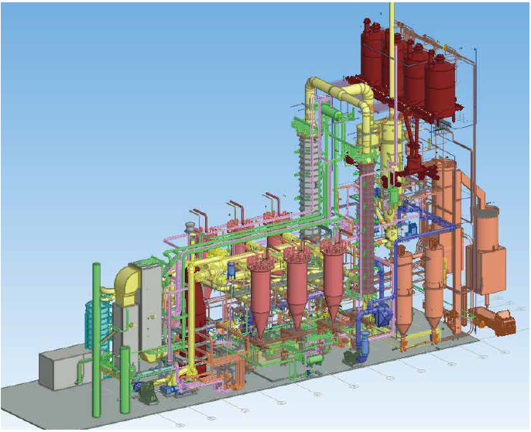
3
Fluidized Bed Gasifiers
Pioneering Sustainable Aviation Fuel (SAF)
through Advanced Gasification
→
Strategic National Project: Partnering with NEDO to establish a stable and efficient SAF supply chain using Japanese expertise.
→
Multi-Feedstock Versatility: Optimized process utilizing a hybrid mix of Biomass (Forest Resources) and Waste Plastics to maximize circularity.
→
Technology Excellence: Utilizing advanced Gasification (SHI core technology) and FT Synthesis to convert diverse waste into high-quality syngas and fuel.
→
Commercial Road-map: Targeted commercial plant operation by the early 2030s, supporting the global shift toward zero-emission aviation.

Slide 12
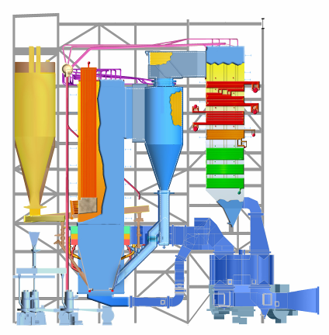
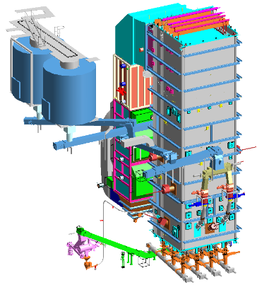
4
Technology Modernization & Upgrade (TMU)
Two approaches to increase Biomass and SRF fuel share
CFB Boiler upgrade
BFB or CFB retrofit
Increasing biomass and/or SRF share in existing CFB boiler
Modifying existing boiler combustion technology to BFB or CFB

Slide 13
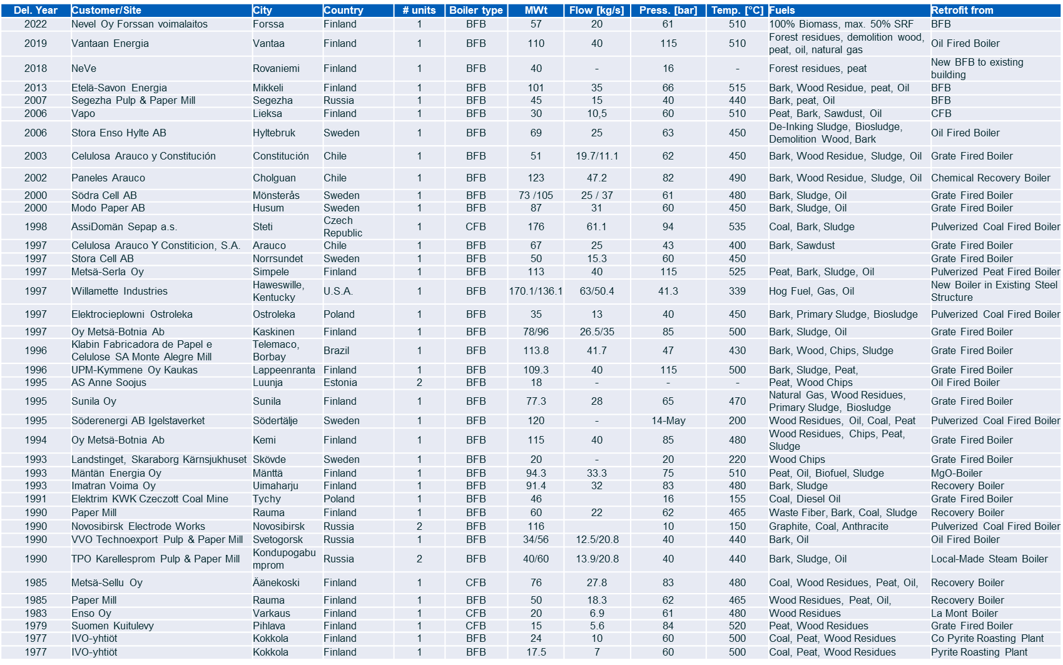
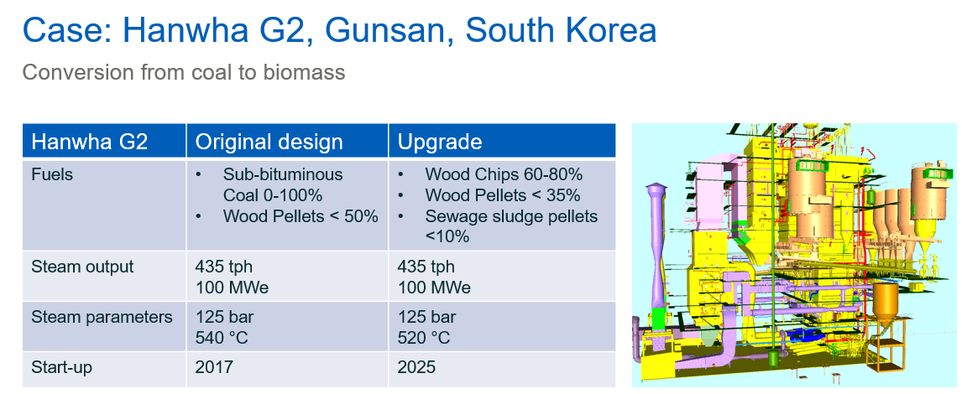
4
Technology Modernization & Upgrade (TMU)
CFB & BFB Retrofit cases around the world
Latest Upgrade Case

